Slide 1
Science Class X
Important questions
Metal Non Metal & Carbon Compounds
toppershome.online

Slide 2
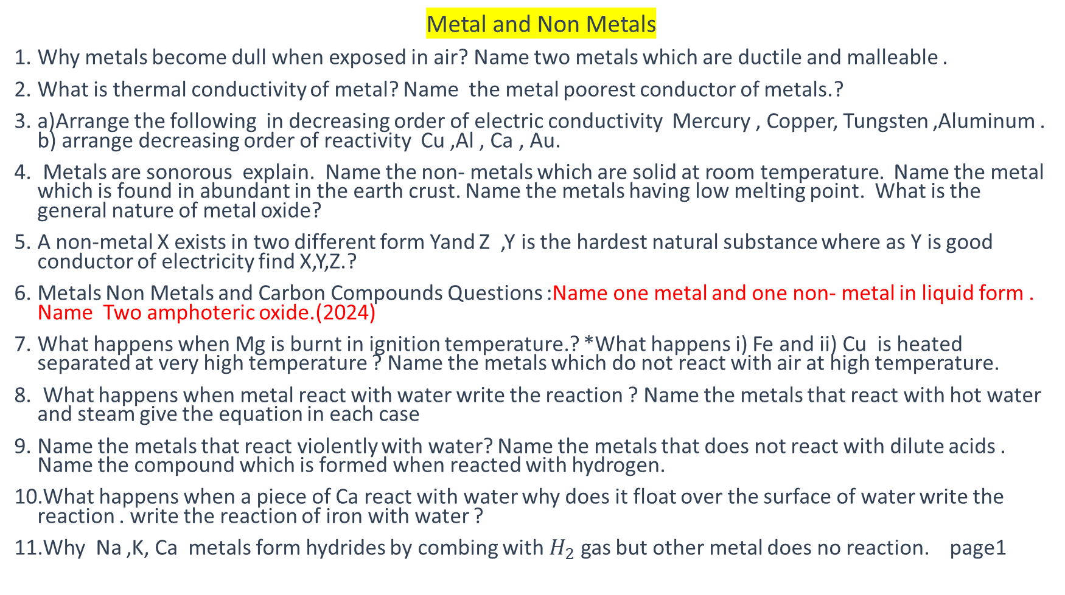
Metal and Non Metals
Why metals become dull when exposed in air? Name two metals which are ductile and malleable .
What is thermal conductivity of metal? Name the metal poorest conductor of metals.?
a)Arrange the following in decreasing order of electric conductivity Mercury , Copper, Tungsten ,Aluminum . b) arrange decreasing order of reactivity Cu ,Al , Ca , Au.
Metals are sonorous explain. Name the non- metals which are solid at room temperature. Name the metal which is found in abundant in the earth crust. Name the metals having low melting point. What is the general nature of metal oxide?
A non-metal X exists in two different form Yand Z ,Y is the hardest natural substance where as Y is good conductor of electricity find X,Y,Z.?
Metals Non Metals and Carbon Compounds Questions :Name one metal and one non- metal in liquid form . Name Two amphoteric oxide.(2024)
What happens when Mg is burnt in ignition temperature.? *What happens i) Fe and ii) Cu is heated separated at very high temperature ? Name the metals which do not react with air at high temperature.
What happens when metal react with water write the reaction ? Name the metals that react with hot water and steam give the equation in each case
Name the metals that react violently with water? Name the metals that does not react with dilute acids . Name the compound which is formed when reacted with hydrogen.
What happens when a piece of Ca react with water why does it float over the surface of water write the reaction . write the reaction of iron with water ?
Why Na ,K, Ca metals form hydrides by combing with $H_{2}$ gas but other metal does no reaction. page1

Slide 3
12.A element M on heating with oxygen form M2O this dissolve in water and turn red litmus blue substance Name M
13.A metal X on heating in air does not burn but acquires black coating substance Y name X and Y with the reaction.
14.what happens when Zn is reacted with CuSO4. write the reaction..
15.P ,Q,R,S,T, represent metals in decreasing order of their reactivity series which of the metal is likely to found in free state and which will be in the top of the series.(Important logical Question Metals Non Metals and Carbon Compounds Questions)
16. Metal A has two oxide first AO second is A2O ,first one is neutral and other is acidic in nature is ” A” metal or non-metal.( Logical Question Metals Non Metals and Carbon Compounds Questions )
17. Name the metal that react with dilute HNO3 give the reaction , Why does Cu does not give H2 gas when react with dilute H2SO4
18.What is electrovalent compounds ,show the formation of NaCl by Na and Cl. ? what can you say about the solubility of electrovalent compounds,
19. Write electronic configuration of element having atomic number 11 , 13
20.Why ionic compound are hard crystalline solids, Name the metals never found in free state.
21.a)Which metal is found as oxide, sulphide in earth’s crust . how are they extracted Name the chemical process used for obtaining metal from metal oxide.. b) why are carbonate and sulphide ores are usually converted into oxide during extraction.
22.write the equation when manganese di oxide is heated with aluminium powder page 2

Slide 4
What is corrosion ? Name the metals which do not corrode . Is corrosion advantageous if so than how ?
Name the metal corrode in atmosphere , Why does silver article become black when left in air name the compound formed and why copper articles becomes greenish if left in air what compound is formed.
Give one word for statement a)Metal oxide behaves as basic and acidic (2024) b) Iodine a non- metal is shining 2024 Oxides of Aluminum and Zinc is—— if reacted with HCl or KOH gives ——–.(Metals Non Metals and Carbon Compounds Questions year 2024)
Write the chemical reaction a)when steam is passed over aluminum/ red hot iron b) CO2 is compressed in water at high pressure c) A copper plate is dipped in the solution of silver nitrate it becomes black why? d) Classify the acidic and basic oxide Na2O, SO2 ,MgO ,CO2 e) ZnS is heated in air (Important Reactions Metals Non Metals and Carbon Compounds Questions )
a)Why no hydrogen gas is evolved when metal react with dilute nitric acid . give the name & reaction of the metal that reacts with it b) Why do ionic compound do not conduct electricity in solid state..
Aluminium is used in making utensil Which of the following property i) Good thermal conductivity ii) good electrical thermal conductivity c) Ductility iv)high melting point .
Which of the following is not ionic compound KCl/ HCl/CCl4/ NaCl.
Which of the following property of ionic compound i) Solubility in water ii) Electric conductivity in solid state iii) high melting and boiling point iv) elctric conductivity in molten state
Galvanization is the method of protection of iron from rusting by coating with thin layer of which metal.
Stainless steel is a mixture of a) Ni and Cr b)Ni and Cu
Na/ Ca/Fe/Cu which of these elements obtained by electrolysis page3

Slide 5
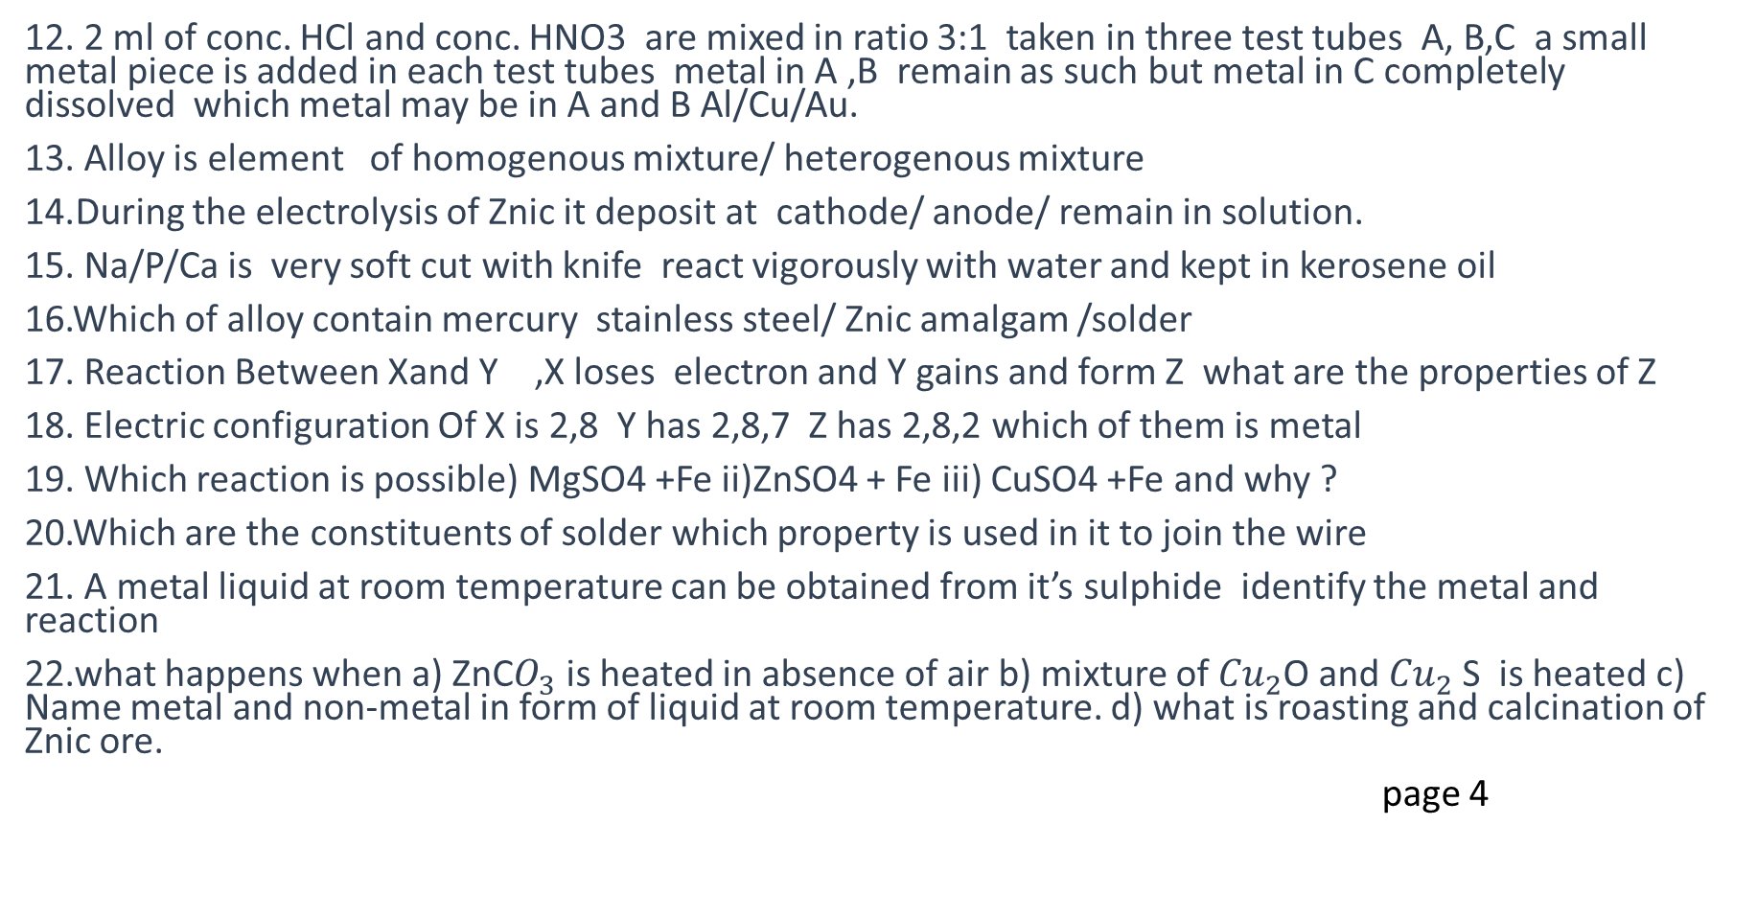
12. 2 ml of conc. HCl and conc. HNO3 are mixed in ratio 3:1 taken in three test tubes A, B,C a small metal piece is added in each test tubes metal in A ,B remain as such but metal in C completely dissolved which metal may be in A and B Al/Cu/Au.
13. Alloy is element of homogenous mixture/ heterogenous mixture
14.During the electrolysis of Znic it deposit at cathode/ anode/ remain in solution.
15. Na/P/Ca is very soft cut with knife react vigorously with water and kept in kerosene oil
16.Which of alloy contain mercury stainless steel/ Znic amalgam /solder
17. Reaction Between Xand Y ,X loses electron and Y gains and form Z what are the properties of Z
18. Electric configuration Of X is 2,8 Y has 2,8,7 Z has 2,8,2 which of them is metal
19. Which reaction is possible) MgSO4 +Fe ii)ZnSO4 + Fe iii) CuSO4 +Fe and why ?
20.Which are the constituents of solder which property is used in it to join the wire
21. A metal liquid at room temperature can be obtained from it’s sulphide identify the metal and reaction
22.what happens when a) ZnC$O_{3}$ is heated in absence of air b) mixture of ${Cu}_{2}$O and ${Cu}_{2}$S is heated c) Name metal and non-metal in form of liquid at room temperature. d) what is roasting and calcination of Znic ore.
page 4

Slide 6
23.A metal and Non metal found in liquid state Ans: Mercury and Bromine(2024)
24.(Important Reactions Metals Non Metals and Carbon Compounds Questions )Which reactions are possible
CaSO4+ Al—->
b) CuSO4+Ca—.>
c) FeSO4 +Cu —-> d) ZnSO4 +Mg—->
25.i)It is observed that Ca when reacted with water floats on the surface of water why it happens so, write balance equation what happens when CO2 is reacted with the product ii) State electroytic refining of copper.
26.An element A react with water to form compound B whichis used in white wash on heating it changes toC which if treated with water gives B again write compound A,B,C and reaction related to it.
27.Metal A does give H2 when react with dilute acid but gives black substance B when reacted with oxygen what is A and B
28.CuSO4 solution is kept in iron container after few day the containers had many wholes why. write the reaction.
29.Explain why a)Reactivity of Al reduces if it is dipped in HNO3 b) Carbon cannot reduce Na and Mg oxides
30.Two metal ore A and B taken on heating A gives CO2 and B gives SO2 what steps will you take to covert into metal page 5

Slide 7
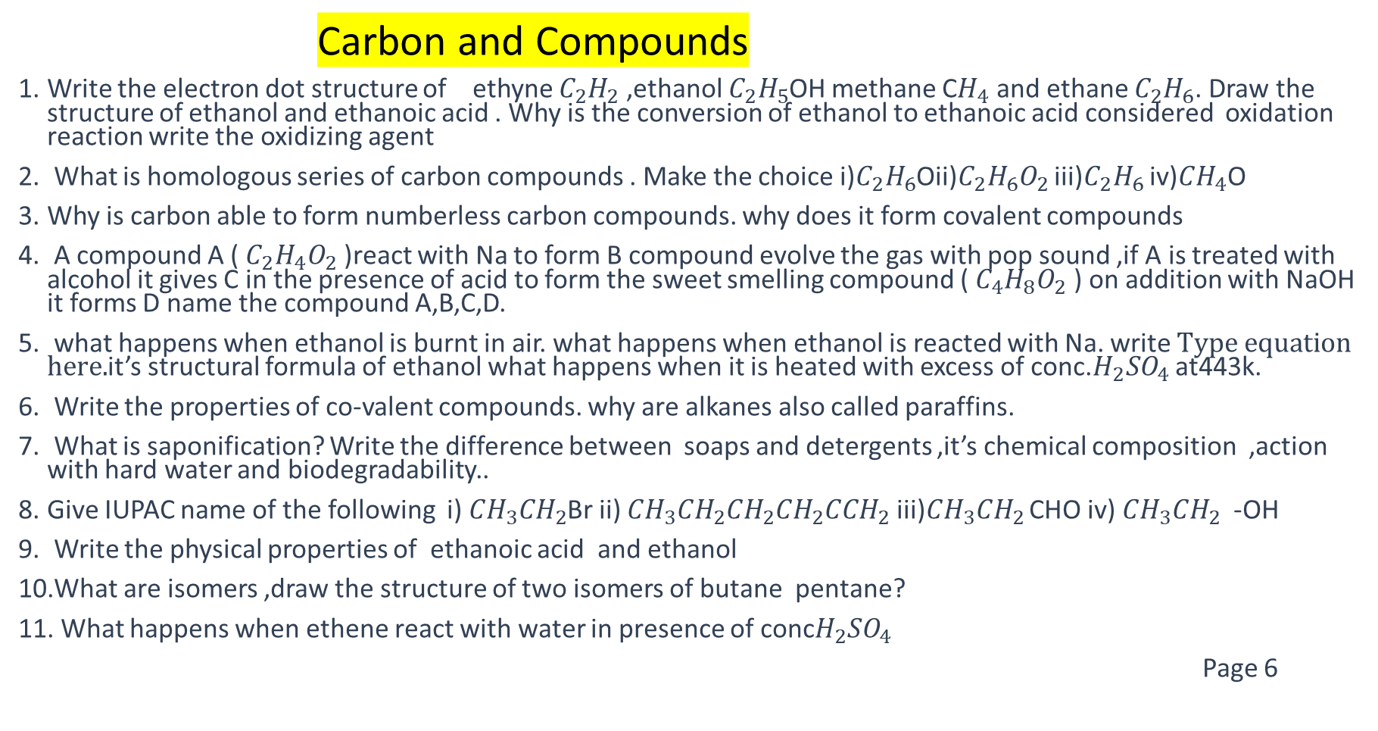
Carbon and Compounds
Write the electron dot structure of ethyne $C_{2}H_{2}$ ,ethanol $C_{2}H_{5}$OH methane C$H_{4}$ and ethane $C_{2}H_{6}$. Draw the structure of ethanol and ethanoic acid . Why is the conversion of ethanol to ethanoic acid considered oxidation reaction write the oxidizing agent
What is homologous series of carbon compounds . Make the choice i)$C_{2}H_{6}$Oii)$C_{2}H_{6}O_{2}$ iii)$C_{2}H_{6}$ iv)${CH}_{4}$O
Why is carbon able to form numberless carbon compounds. why does it form covalent compounds
A compound A ( $C_{2}H_{4}O_{2}$ )react with Na to form B compound evolve the gas with pop sound ,if A is treated with alcohol it gives C in the presence of acid to form the sweet smelling compound ( $C_{4}H_{8}O_{2}$ ) on addition with NaOH it forms D name the compound A,B,C,D.
what happens when ethanol is burnt in air. what happens when ethanol is reacted with Na. write it’s structural formula of ethanol what happens when it is heated with excess of conc.$H_{2}{SO}_{4}$ at443k.
Write the properties of co-valent compounds. why are alkanes also called paraffins.
What is saponification? Write the difference between soaps and detergents ,it’s chemical composition ,action with hard water and biodegradability..
Give IUPAC name of the following i) ${CH}_{3}{CH}_{2}$Br ii) ${CH}_{3}{CH}_{2}{CH}_{2}{CH}_{2}{CCH}_{2}$ iii)${CH}_{3}{CH}_{2}$ CHO iv) ${CH}_{3}{CH}_{2}$ -OH
Write the physical properties of ethanoic acid and ethanol
What are isomers ,draw the structure of two isomers of butane pentane?
What happens when ethene react with water in presence of conc$H_{2}{SO}_{4}$
Page 6

Slide 8
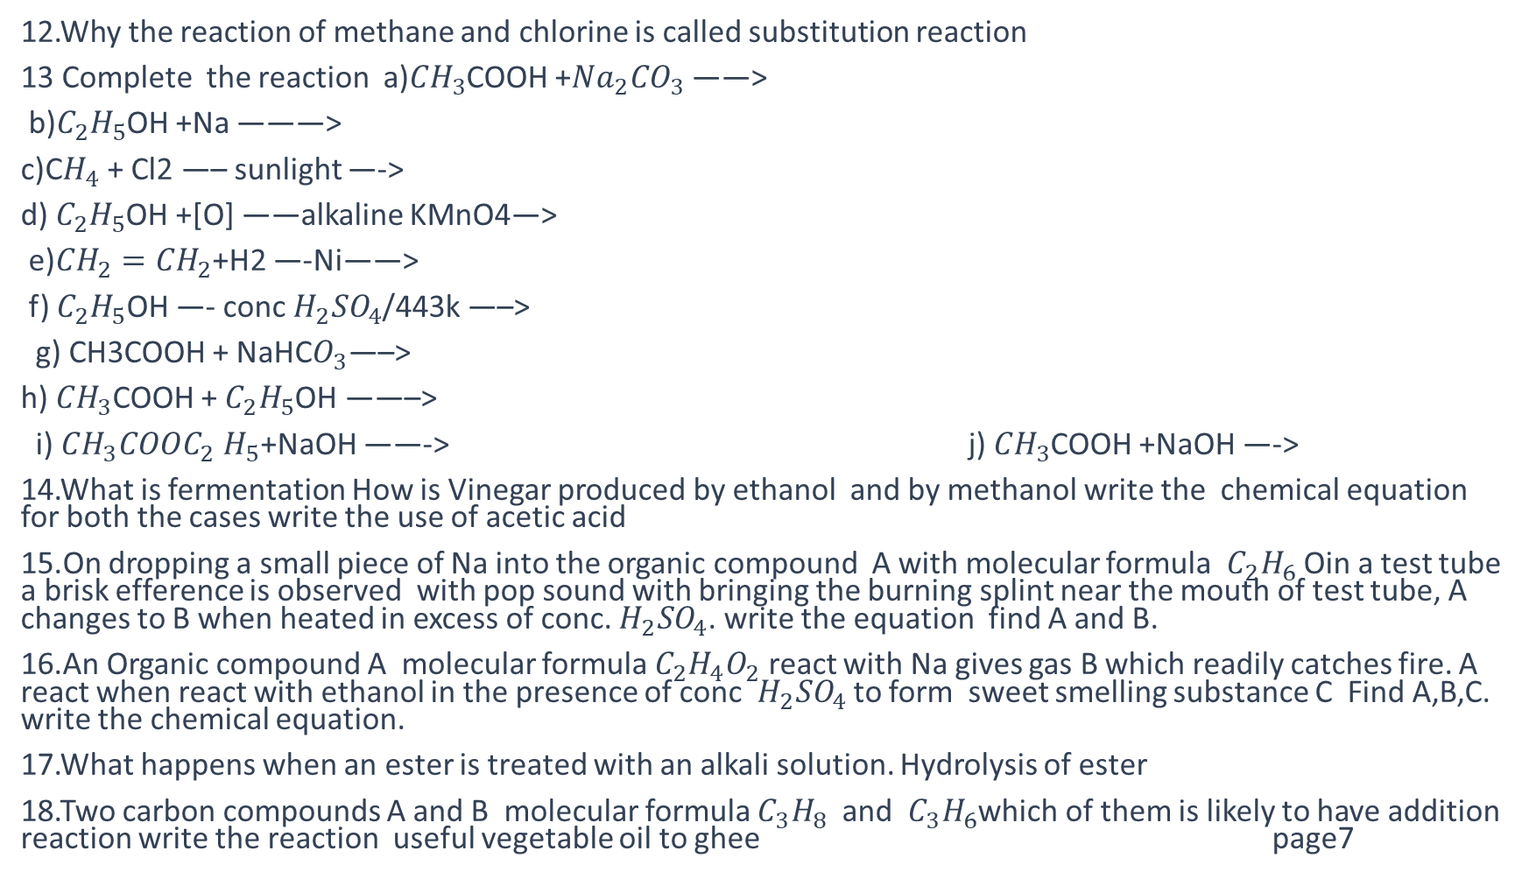
12.Why the reaction of methane and chlorine is called substitution reaction
13 Complete the reaction a)${CH}_{3}$COOH +${Na}_{2}{CO}_{3}$ ——>
b)$C_{2}H_{5}$OH +Na ———>
c)C$H_{4}$ + Cl2 —– sunlight —->
d) $C_{2}H_{5}$OH +[O] ——alkaline KMnO4—>
e)${CH}_{2}{=CH}_{2}$+H2 —-Ni——>
f) $C_{2}H_{5}$OH —- conc $H_{2}{SO}_{4}$/443k —–>
g) CH3COOH + NaHC$O_{3}$—–>
h) ${CH}_{3}$COOH + $C_{2}H_{5}$OH ——–>
i) ${CH}_{3}{COOC}_{2}$ $H_{5}$+NaOH ——-> j) ${CH}_{3}$COOH +NaOH —->
14.What is fermentation How is Vinegar produced by ethanol and by methanol write the chemical equation for both the cases write the use of acetic acid
15.On dropping a small piece of Na into the organic compound A with molecular formula $C_{2}H_{6}$ Oin a test tube a brisk efference is observed with pop sound with bringing the burning splint near the mouth of test tube, A changes to B when heated in excess of conc. $H_{2}{SO}_{4}$. write the equation find A and B.
16.An Organic compound A molecular formula $C_{2}H_{4}O_{2}$ react with Na gives gas B which readily catches fire. A react when react with ethanol in the presence of conc $H_{2}{SO}_{4}$ to form sweet smelling substance C Find A,B,C. write the chemical equation.
17.What happens when an ester is treated with an alkali solution. Hydrolysis of ester
18.Two carbon compounds A and B molecular formula $C_{3}H_{8}$ and $C_{3}H_{6}$which of them is likely to have addition reaction write the reaction useful vegetable oil to ghee page7

