Slide 1
Important Mathematics Questions part 2
Class x
toppershome.online

Slide 2
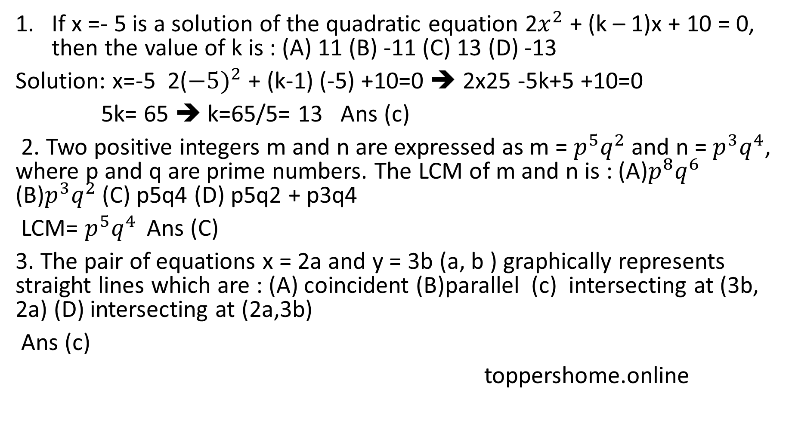
If x =- 5 is a solution of the quadratic equation 2$x^{2}$ + (k – 1)x + 10 = 0, then the value of k is : (A) 11 (B) -11 (C) 13 (D) -13
Solution: x=-5 2(${−5)}^{2}$ + (k-1) (-5) +10=0 ➔ 2x25 -5k+5 +10=0
5k= 65 ➔ k=65/5= 13 Ans (c)
2. Two positive integers m and n are expressed as m = $p^{5}q^{2}$ and n = $p^{3}q^{4}$, where p and q are prime numbers. The LCM of m and n is : (A)$p^{8}q^{6}$ (B)$p^{3}q^{2}$ (C) p5q4 (D) p5q2 + p3q4
LCM= $p^{5}q^{4 }$ Ans (C)
3. The pair of equations x = 2a and y = 3b (a, b ) graphically represents straight lines which are : (A) coincident (B)parallel (c) intersecting at (3b, 2a) (D) intersecting at (2a,3b)
Ans (c)
toppershome.online

Slide 3
toppershome.online
4.If k + 7, 2k – 2 and 2k + 6 are three consecutive terms of an A.P., then the value of k is : (A)15 (B) 17 (c ) 5 (D) 1
Solution: Common Difference is same in AP
2k-2 – (K+7) = 2k+6- (2k-2) ➔ 2k -2 –k-7 = 2k +6 -2k+2
k=17
5. . The LCM of smallest two digit composite number and smallest composite number is: a) 12 b) 4 c) 20 d) 44
Ans(c) the smallest composite number is 4 and two digit composite number is 10 than LCM of both is 20
6. The pair of equations y = 0 and y = -7 has: a) one solution b) two solutions c) infinitely many solutions d) no solution
Ans(d) as they are parallel lines so no solution

Slide 4
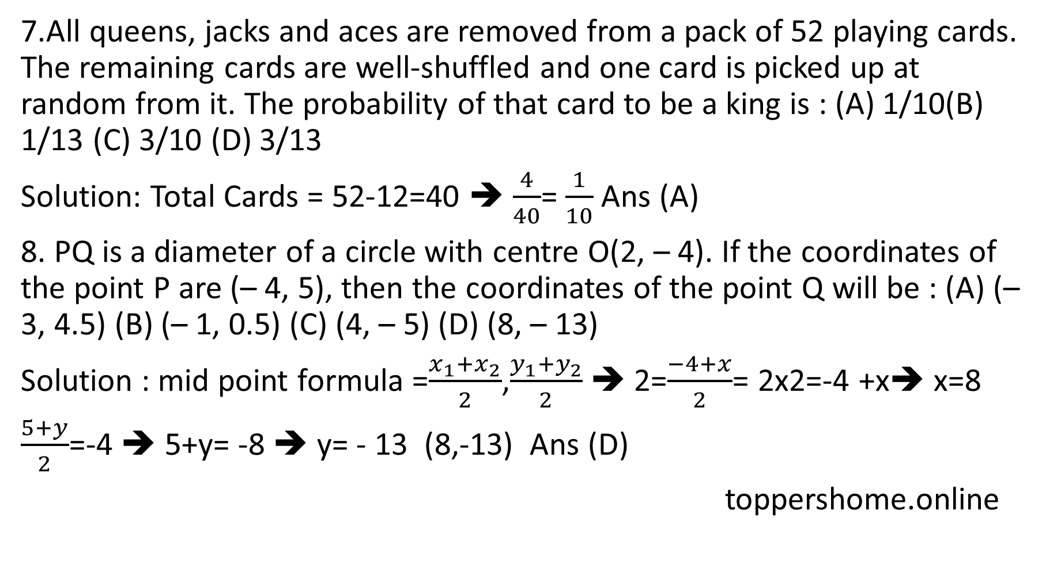
7.All queens, jacks and aces are removed from a pack of 52 playing cards. The remaining cards are well-shuffled and one card is picked up at random from it. The probability of that card to be a king is : (A) 1/10(B) 1/13 (C) 3/10 (D) 3/13
Solution: Total Cards = 52-12=40 ➔ $\frac{4}{40}$= $\frac{1}{10}$ Ans (A)
8. PQ is a diameter of a circle with centre O(2, – 4). If the coordinates of the point P are (– 4, 5), then the coordinates of the point Q will be : (A) (– 3, 4.5) (B) (– 1, 0.5) (C) (4, – 5) (D) (8, – 13)
Solution : mid point formula =$\frac{x_{1}+x_{2}}{2}$,$\frac{y_{1}+y_{2}}{2}$ ➔ 2=$\frac{−4+x}{2}$= 2x2=-4 +x➔ x=8
$\frac{5+y}{2}$=-4 ➔ 5+y= -8 ➔ y= - 13 (8,-13) Ans (D)
toppershome.online

Slide 5
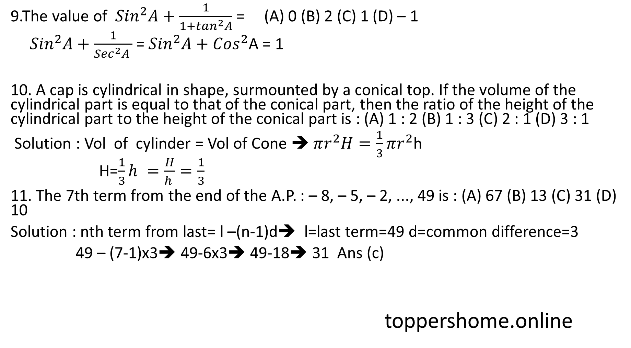
9.The value of ${Sin}^{2}A+\frac{1}{1+\tan^{2}A}$ = (A) 0 (B) 2 (C) 1 (D) – 1
${Sin}^{2}A+\frac{1}{{Sec}^{2}A }$ = ${Sin}^{2}A+{Cos}^{2}$A = 1
10. A cap is cylindrical in shape, surmounted by a conical top. If the volume of the cylindrical part is equal to that of the conical part, then the ratio of the height of the cylindrical part to the height of the conical part is : (A) 1 : 2 (B) 1 : 3 (C) 2 : 1 (D) 3 : 1
Solution : Vol of cylinder = Vol of Cone ➔ $πr^{2}H=\frac{1}{3}πr^{2}$h
H=$\frac{1}{3}h =\frac{H}{h }=\frac{1}{3}$
11. The 7th term from the end of the A.P. : – 8, – 5, – 2, ..., 49 is : (A) 67 (B) 13 (C) 31 (D) 10
Solution : nth term from last= l –(n-1)d➔ l=last term=49 d=common difference=3
49 – (7-1)x3➔ 49-6x3➔ 49-18➔ 31 Ans (c)
toppershome.online

Slide 6
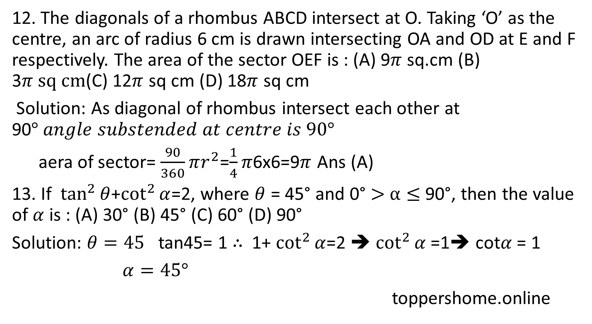
12. The diagonals of a rhombus ABCD intersect at O. Taking ‘O’ as the centre, an arc of radius 6 cm is drawn intersecting OA and OD at E and F respectively. The area of the sector OEF is : (A) 9$π$ sq.cm (B) 3$π sq cm$(C) 12$π$ sq cm (D) 18$π$ sq cm
Solution: As diagonal of rhombus intersect each other at 90$° angle substended at centre is 90°$
aera of sector= $\frac{90}{360}πr^{2}$=$\frac{1}{4}π$6x6=9$π$ Ans (A)
13. If $\tan^{2}{θ}$+$\cot^{2}{α}$=2, where $θ$ = 45° and 0° $>$ $α≤$ 90°, then the value of $α$ is : (A) 30° (B) 45° (C) 60° (D) 90°
Solution: $θ=45$ tan45= 1 $∴$ 1+ $\cot^{2}{α}$=2 ➔ $\cot^{2}{α}$ =1➔ cot$α$ = 1
$α=45°$
toppershome.online

Slide 7
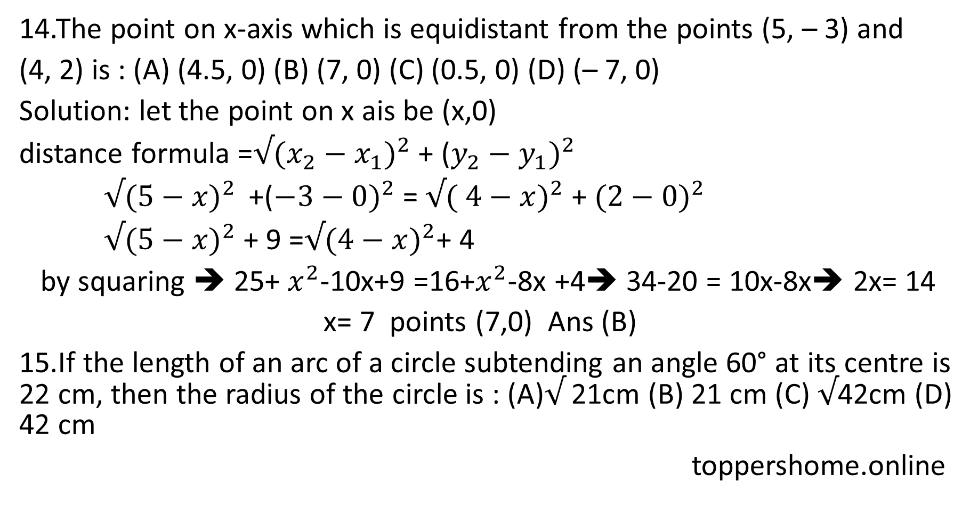
14.The point on x-axis which is equidistant from the points (5, – 3) and
(4, 2) is : (A) (4.5, 0) (B) (7, 0) (C) (0.5, 0) (D) (– 7, 0)
Solution: let the point on x ais be (x,0)
distance formula =$√({x_{2}−x_{1})}^{2}$ + (${y_{2}−y_{1})}^{2}$
$√({5−x)}^{2 }$ +(${−3−0)}^{2}$ = $√{( 4−x)}^{2}$ + ${(2−0)}^{2}$
$√{(5−x)}^{2}$ + 9 =$√{(4−x)}^{2}$+ 4
by squaring ➔ 25+ $x^{2}$-10x+9 =16+$x^{2}$-8x +4➔ 34-20 = 10x-8x➔ 2x= 14
x= 7 points (7,0) Ans (B)
15.If the length of an arc of a circle subtending an angle 60° at its centre is 22 cm, then the radius of the circle is : (A)$√$ 21cm (B) 21 cm (C) $√$42cm (D) 42 cm
toppershome.online

Slide 8
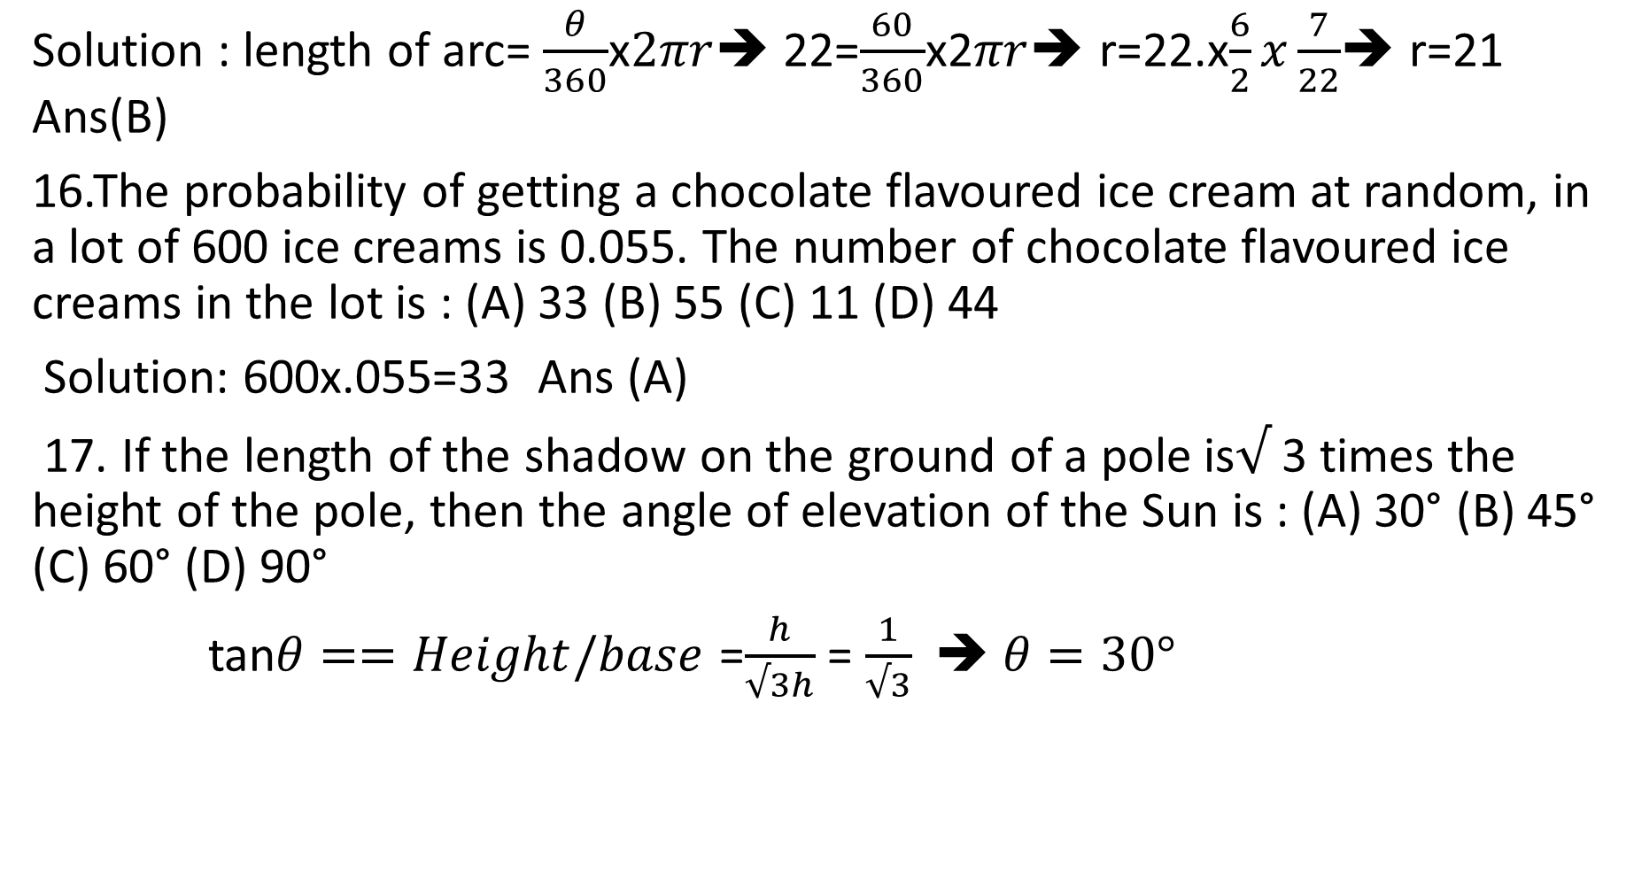
Solution : length of arc= $\frac{θ}{360}$x$2πr$➔ 22=$\frac{60}{360}$x2$πr$➔ r=22.x$\frac{6}{2}x\frac{7}{22}$➔ r=21 Ans(B)
16.The probability of getting a chocolate flavoured ice cream at random, in a lot of 600 ice creams is 0.055. The number of chocolate flavoured ice creams in the lot is : (A) 33 (B) 55 (C) 11 (D) 44
Solution: 600x.055=33 Ans (A)
17. If the length of the shadow on the ground of a pole is$√$ 3 times the height of the pole, then the angle of elevation of the Sun is : (A) 30° (B) 45° (C) 60° (D) 90°
tan$θ==Height/base$ =$\frac{h}{√3h}$ = $\frac{1}{√3}$ ➔ $θ=30°$

Slide 9
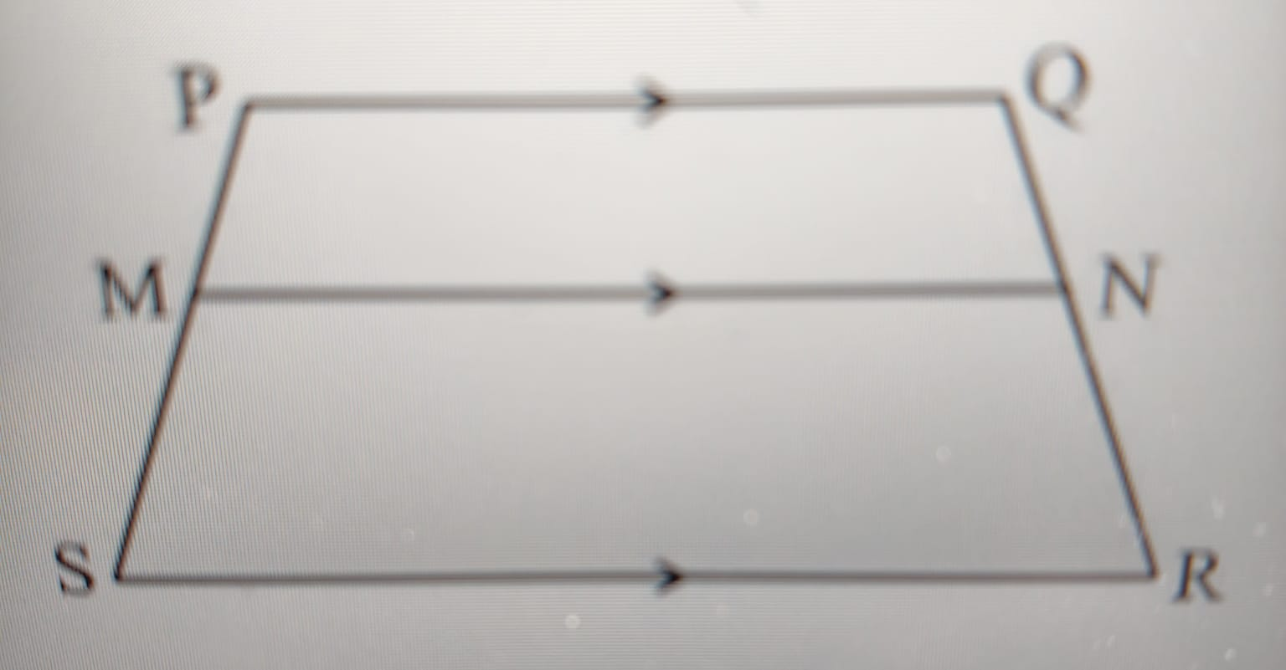
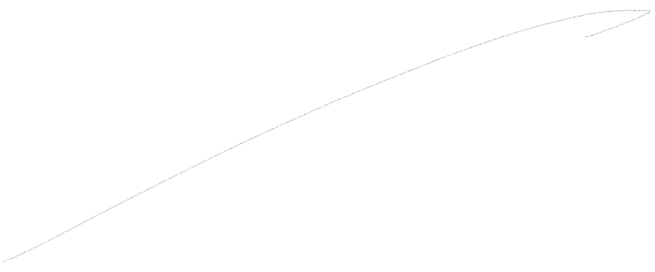
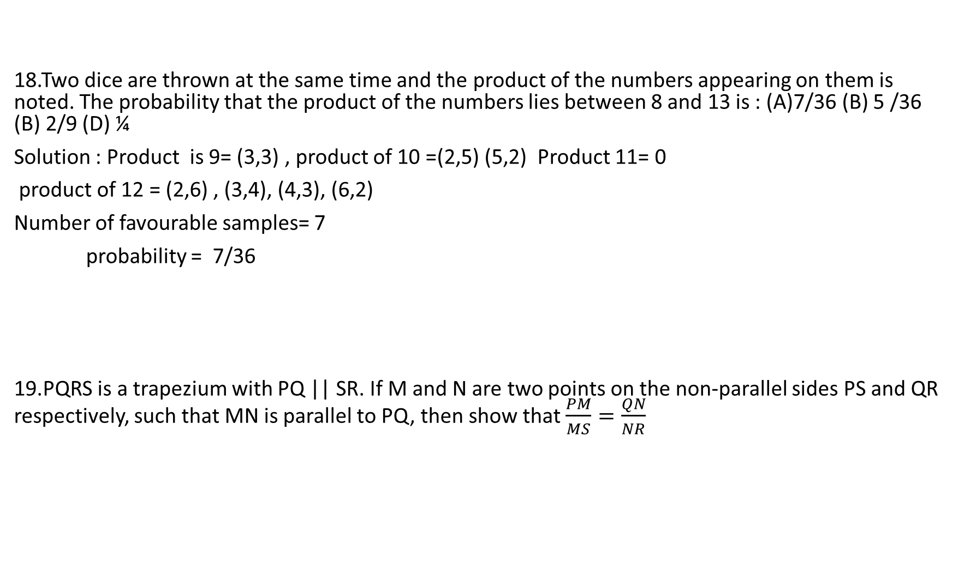
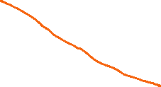
18.Two dice are thrown at the same time and the product of the numbers appearing on them is noted. The probability that the product of the numbers lies between 8 and 13 is : (A)7/36 (B) 5 /36 (B) 2/9 (D) ¼
Solution : Product is 9= (3,3) , product of 10 =(2,5) (5,2) Product 11= 0
product of 12 = (2,6) , (3,4), (4,3), (6,2)
Number of favourable samples= 7
probability = 7/36
19.PQRS is a trapezium with PQ || SR. If M and N are two points on the non-parallel sides PS and QR respectively, such that MN is parallel to PQ, then show that $\frac{PM}{MS}=\frac{QN}{NR}$

Slide 10
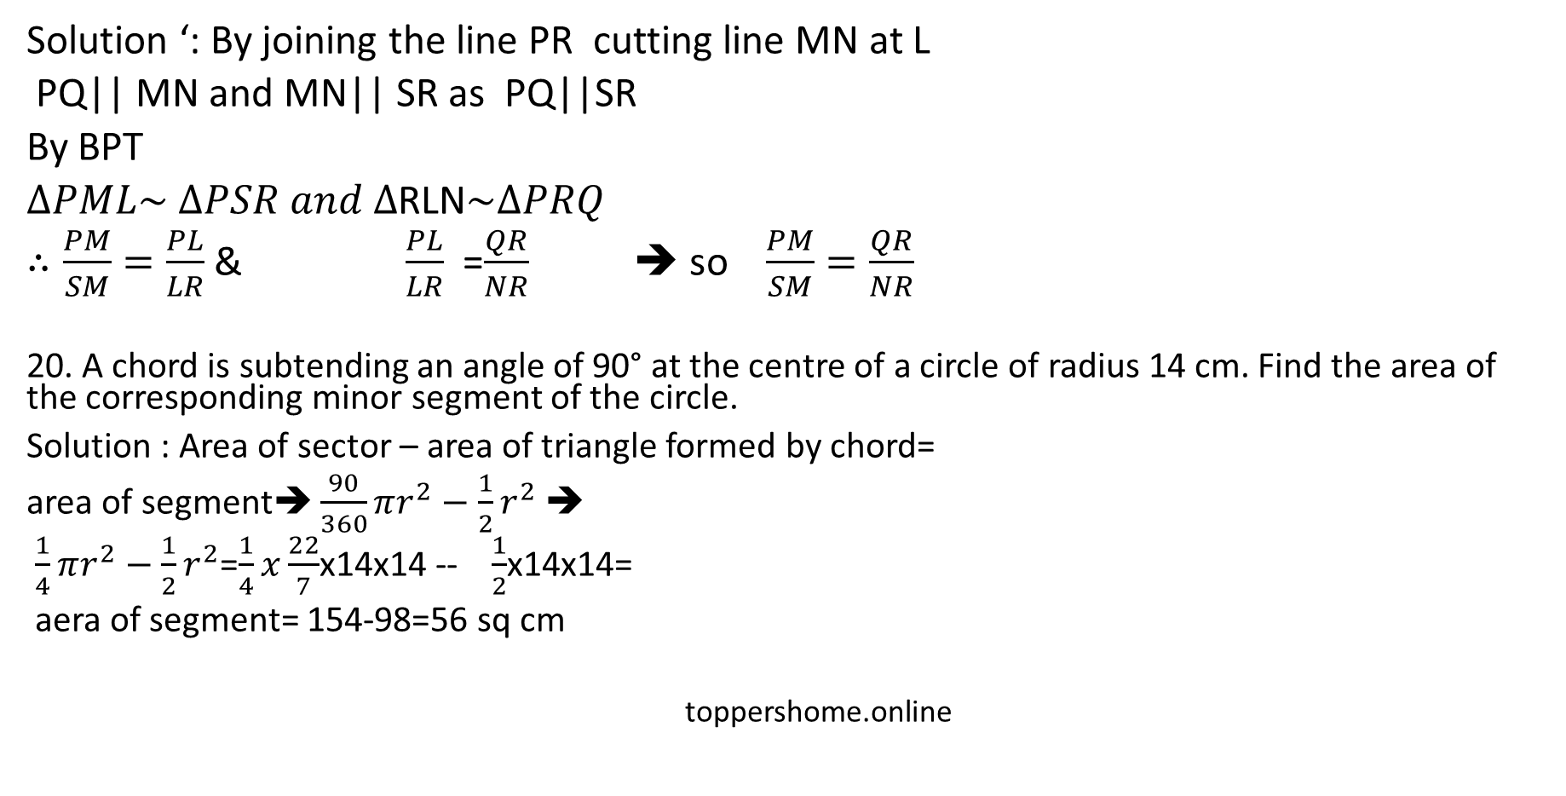
Solution ‘: By joining the line PR cutting line MN at L
PQ|| MN and MN|| SR as PQ||SR
By BPT
$∆PML\sim ∆PSR and ∆$RLN$\sim ∆PRQ$
$∴\frac{PM}{SM}=\frac{PL}{LR}$ & $\frac{PL}{LR}$ =$\frac{QR}{NR}$ ➔ so $\frac{PM}{SM}=\frac{QR}{NR}$
20. A chord is subtending an angle of 90° at the centre of a circle of radius 14 cm. Find the area of the corresponding minor segment of the circle.
Solution : Area of sector – area of triangle formed by chord=
area of segment➔ $\frac{90}{360}πr^{2}−\frac{1}{2}r^{2}$ ➔
$\frac{1}{4}πr^{2}−\frac{1}{2}r^{2}$=$\frac{1}{4}x\frac{22}{7}$x14x14 -- $\frac{1}{2}$x14x14=
aera of segment= 154-98=56 sq cm
toppershome.online

Slide 11
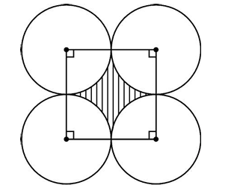
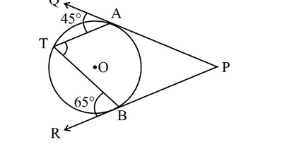

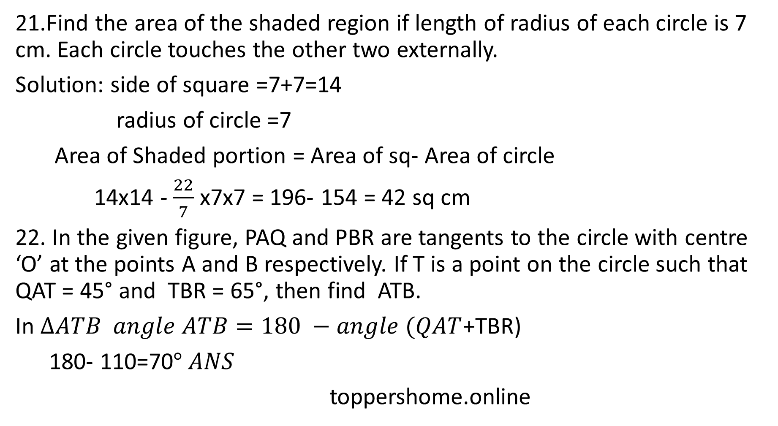


21.Find the area of the shaded region if length of radius of each circle is 7 cm. Each circle touches the other two externally.
Solution: side of square =7+7=14
radius of circle =7
Area of Shaded portion = Area of sq- Area of circle
14x14 - $\frac{22}{7}$ x7x7 = 196- 154 = 42 sq cm
22. In the given figure, PAQ and PBR are tangents to the circle with centre ‘O’ at the points A and B respectively. If T is a point on the circle such that QAT = 45° and TBR = 65°, then find ATB.
In $∆ATB angle ATB=180 −angle (QAT$+TBR)
180- 110=70$° ANS$
toppershome.online

Slide 12

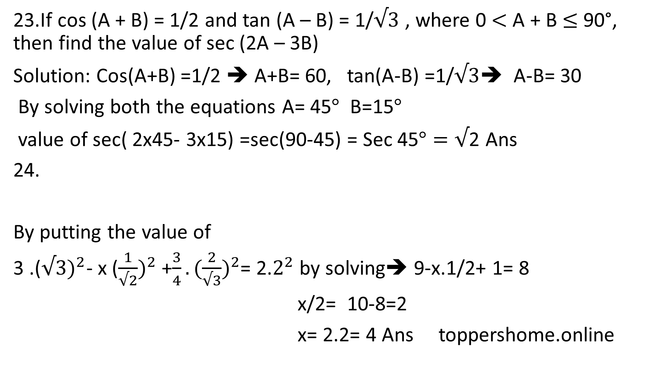
23.If cos (A + B) = 1/2 and tan (A – B) = 1/$√3$ , where 0 $<$ A + B $≤$ 90°, then find the value of sec (2A – 3B)
Solution: Cos(A+B) =1/2 ➔ A+B= 60, tan(A-B) =1/$√3$➔ A-B= 30
By solving both the equations A= 45$°$ B=15$°$
value of sec( 2x45- 3x15) =sec(90-45) = Sec 45$°=√$2 Ans
24.
By putting the value of
3 .(${√3)}^{2}$- x (${\frac{1}{√2})}^{2}$ +$\frac{3}{4}.(\frac{2}{√3})^{2}$= 2.$2^{2}$ by solving➔ 9-x.1/2+ 1= 8
x/2= 10-8=2
x= 2.2= 4 Ans toppershome.online

Slide 13
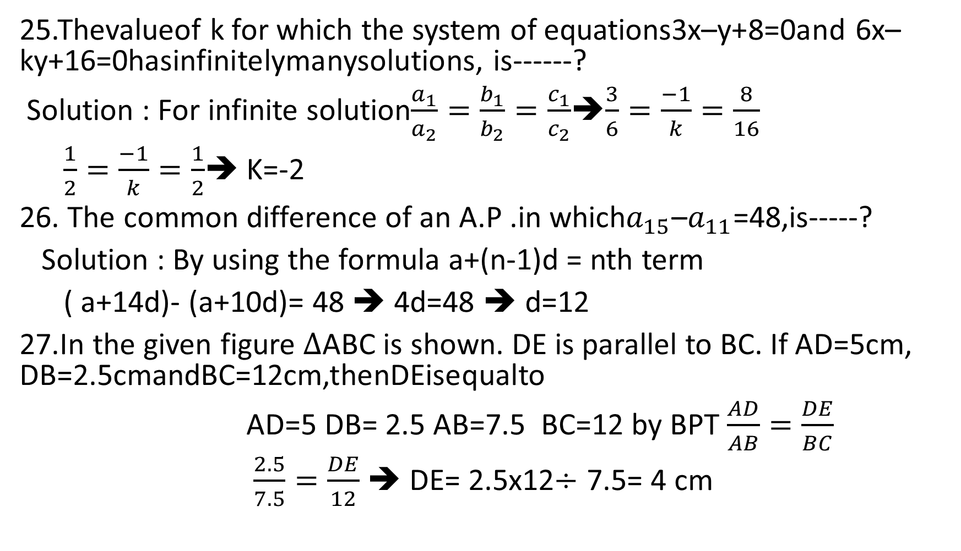
25.Thevalueof k for which the system of equations3x–y+8=0and 6x–ky+16=0hasinfinitelymanysolutions, is------?
Solution : For infinite solution$\frac{a_{1}}{a_{2}}=\frac{b_{1}}{b_{2}}=\frac{c_{1}}{c_{2}}$➔$\frac{3}{6}=\frac{−1}{k}=\frac{8}{16}$
$\frac{1}{2}=\frac{−1}{k}=\frac{1}{2}$➔ K=-2
26. The common difference of an A.P .in which$a_{15}$–$a_{11}$=48,is-----?
Solution : By using the formula a+(n-1)d = nth term
( a+14d)- (a+10d)= 48 ➔ 4d=48 ➔ d=12
27.In the given figure $∆$ABC is shown. DE is parallel to BC. If AD=5cm, DB=2.5cmandBC=12cm,thenDEisequalto
AD=5 DB= 2.5 AB=7.5 BC=12 by BPT $\frac{AD}{AB}=\frac{DE}{BC}$
$\frac{2.5}{7.5}=\frac{DE}{12}$ ➔ DE= 2.5x12$÷$ 7.5= 4 cm

Slide 14
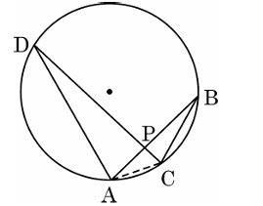
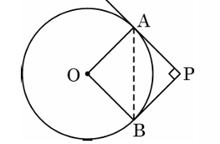
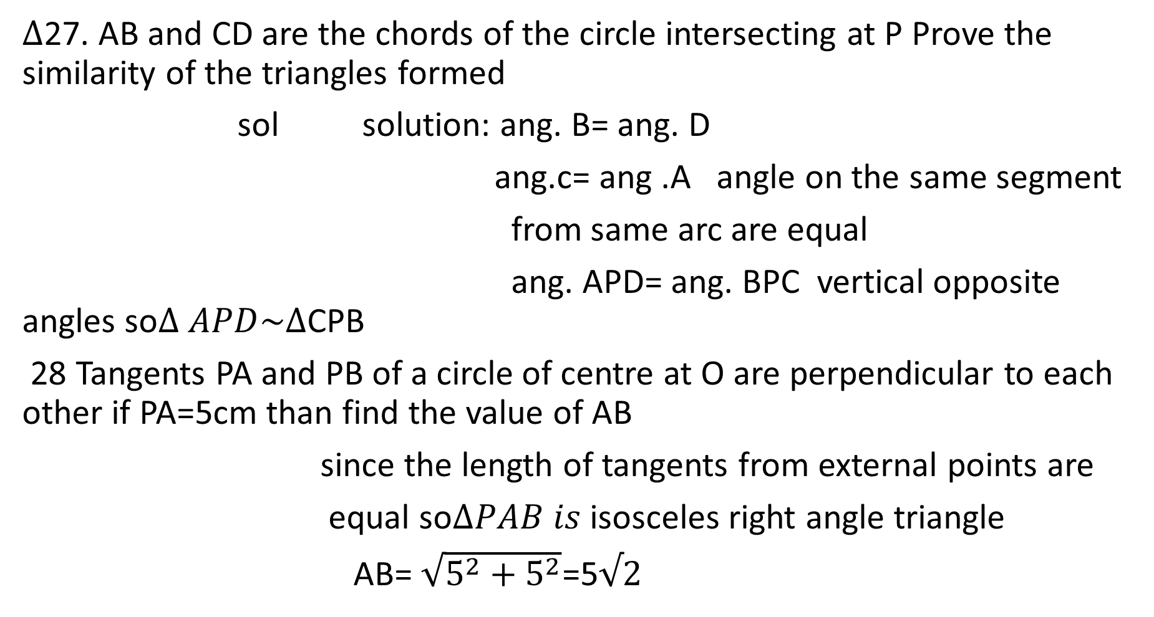
$∆$27. AB and CD are the chords of the circle intersecting at P Prove the similarity of the triangles formed
sol solution: ang. B= ang. D
ang.c= ang .A angle on the same segment
from same arc are equal
ang. APD= ang. BPC vertical opposite angles so$∆ APD\sim ∆$CPB
28 Tangents PA and PB of a circle of centre at O are perpendicular to each other if PA=5cm than find the value of AB
since the length of tangents from external points are
equal so$∆PAB is$ isosceles right angle triangle
AB= $\sqrt{5^{2}+5^{2}}$=5$√2$

Slide 15
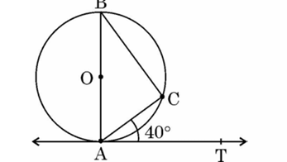
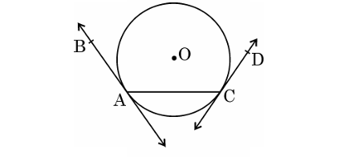
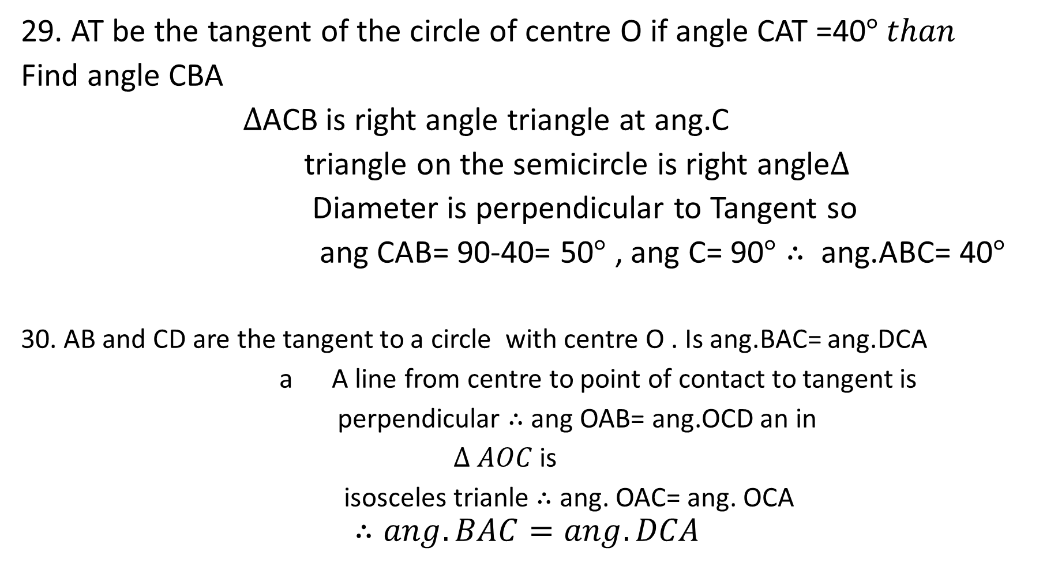

29. AT be the tangent of the circle of centre O if angle CAT =40$° than$
Find angle CBA
$∆$ACB is right angle triangle at ang.C
triangle on the semicircle is right angle$∆$
Diameter is perpendicular to Tangent so
ang CAB= 90-40= 50$°$ , ang C= 90$°∴$ ang.ABC= 40$°$
30. AB and CD are the tangent to a circle with centre O . Is ang.BAC= ang.DCA
a A line from centre to point of contact to tangent is
perpendicular $∴$ang OAB= ang.OCD an in
$∆ AOC$ is
isosceles trianle $∴$ ang. OAC= ang. OCA
$$∴ang.BAC=ang. DCA$$

