Slide 1
Important Mathematics
Questions
Class X
toppershome.online

Slide 2
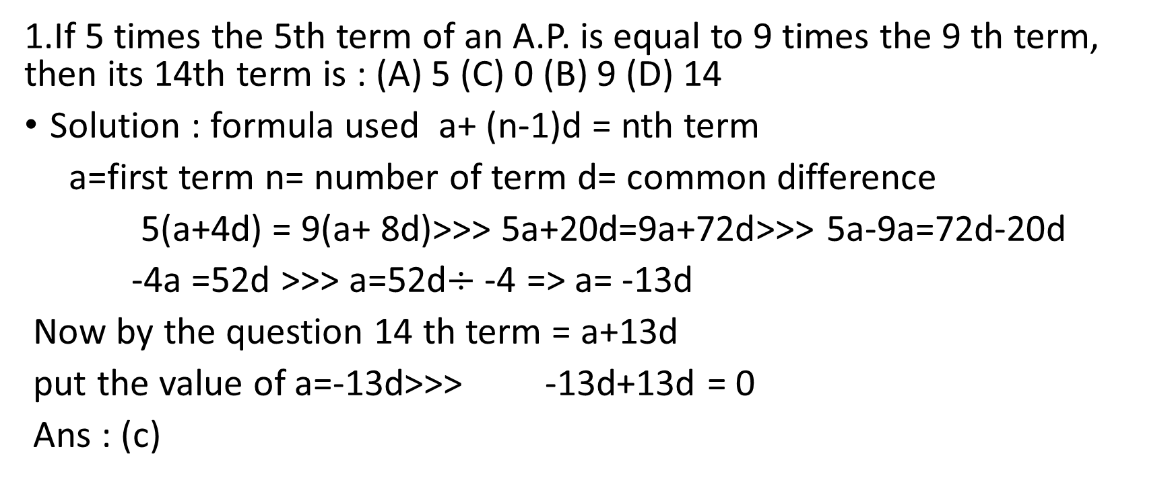
1.If 5 times the 5th term of an A.P. is equal to 9 times the 9 th term, then its 14th term is : (A) 5 (C) 0 (B) 9 (D) 14
Solution : formula used a+ (n-1)d = nth term
a=first term n= number of term d= common difference
5(a+4d) = 9(a+ 8d)>>> 5a+20d=9a+72d>>> 5a-9a=72d-20d
-4a =52d >>> a=52d$÷$-4 => a= -13d
Now by the question 14 th term = a+13d
put the value of a=-13d>>> -13d+13d = 0
Ans : (c)

Slide 3
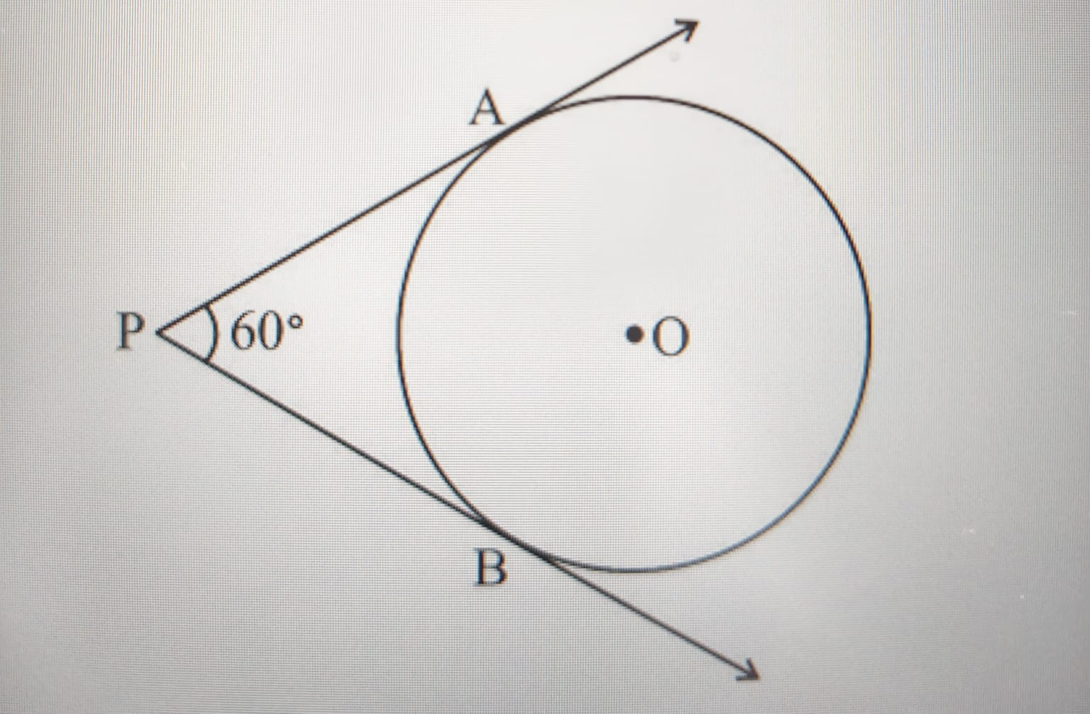
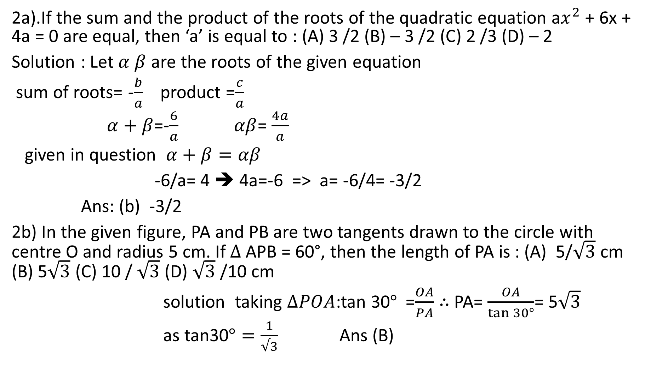
2a).If the sum and the product of the roots of the quadratic equation a$x^{2}$ + 6x + 4a = 0 are equal, then ‘a’ is equal to : (A) 3 /2 (B) – 3 /2 (C) 2 /3 (D) – 2
Solution : Let $α β$ are the roots of the given equation
sum of roots= -$\frac{b}{a}$ product =$\frac{c}{a}$
$α+β$=-$\frac{6}{a}$ $αβ$= $\frac{4a}{a}$
given in question $α+β=αβ$
-6/a= 4 ➔ 4a=-6 => a= -6/4= -3/2
Ans: (b) -3/2
2b) In the given figure, PA and PB are two tangents drawn to the circle with centre O and radius 5 cm. If $∆$ APB = 60°, then the length of PA is : (A) 5/$\sqrt{3}$ cm (B) 5$\sqrt{3}$ (C) 10 / $\sqrt{3}$ (D) $\sqrt{3}$ /10 cm
solution taking $∆POA$:tan 30$°$=$\frac{OA}{PA}$ $∴$ PA= $\frac{OA}{\tan{30°}}$= 5$\sqrt{3}$
as tan30$°=\frac{1}{√3}$ Ans (B)

Slide 4
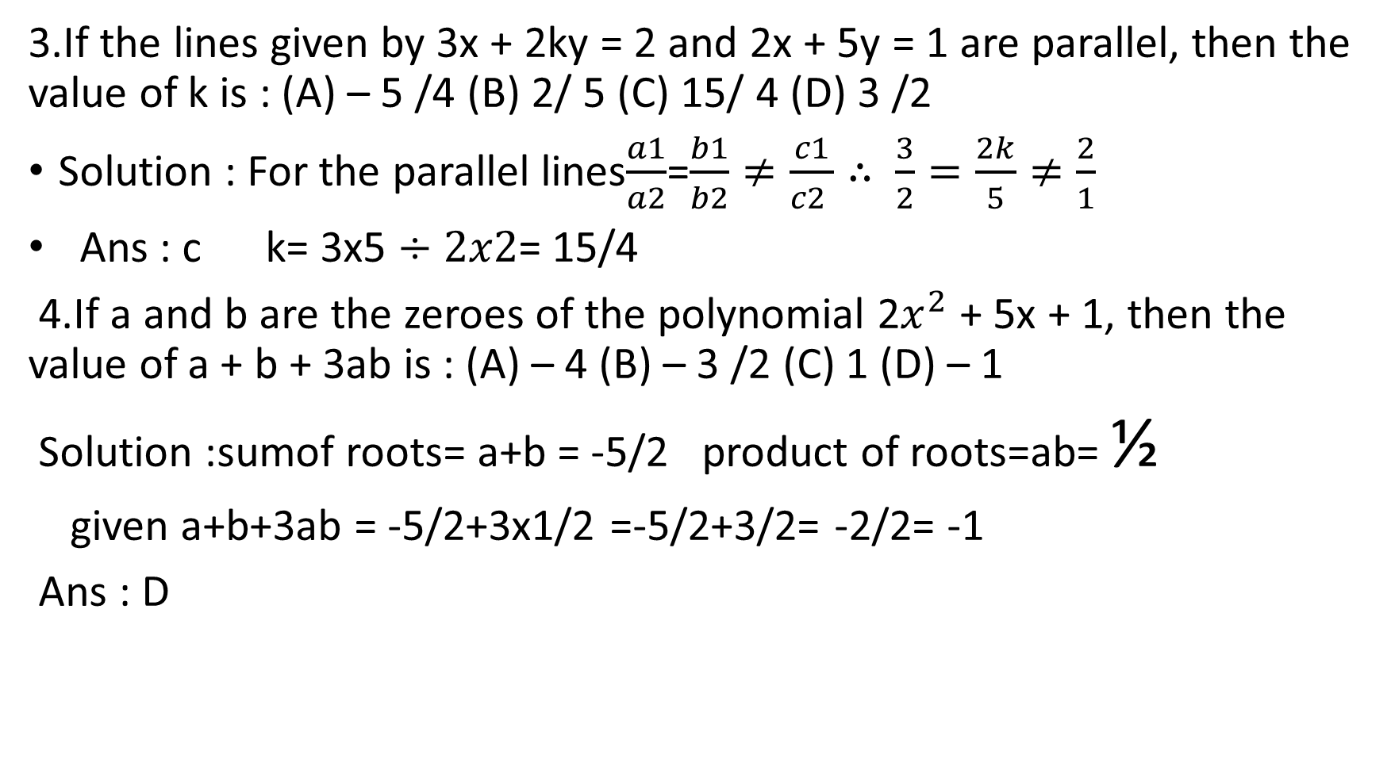
3.If the lines given by 3x + 2ky = 2 and 2x + 5y = 1 are parallel, then the value of k is : (A) – 5 /4 (B) 2/ 5 (C) 15/ 4 (D) 3 /2
Solution : For the parallel lines$\frac{a1}{a2}$=$\frac{b1}{b2}≠\frac{c1}{c2 }∴$ $\frac{3}{2}=\frac{2k}{5}≠\frac{2}{1}$
Ans : c k= 3x5 $÷2x2$= 15/4
4.If a and b are the zeroes of the polynomial 2$x^{2}$ + 5x + 1, then the value of a + b + 3ab is : (A) – 4 (B) – 3 /2 (C) 1 (D) – 1
Solution :sumof roots= a+b = -5/2 product of roots=ab= ½
given a+b+3ab = -5/2+3x1/2 =-5/2+3/2= -2/2= -1
Ans : D

Slide 5
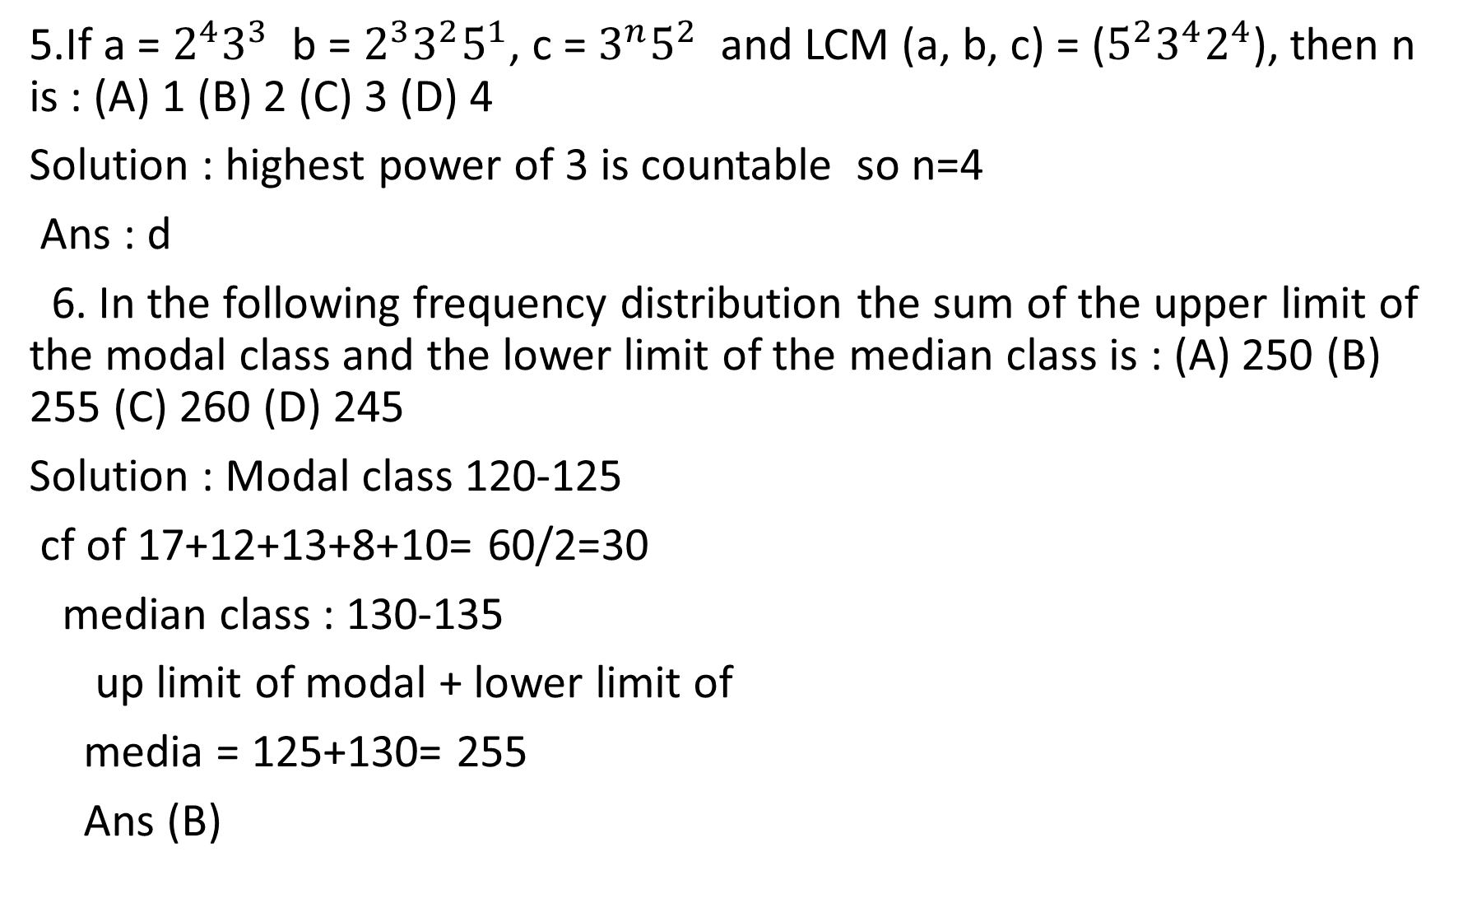
5.If a = $2^{4}3^{3}$ b = $2^{3}3^{2}5^{1}$, c = $3^{n}5^{2}$ and LCM (a, b, c) = ($5^{2}3^{4}2^{4}$), then n is : (A) 1 (B) 2 (C) 3 (D) 4
Solution : highest power of 3 is countable so n=4
Ans : d
6. In the following frequency distribution the sum of the upper limit of the modal class and the lower limit of the median class is : (A) 250 (B) 255 (C) 260 (D) 245
Solution : Modal class 120-125
cf of 17+12+13+8+10= 60/2=30
median class : 130-135
up limit of modal + lower limit of
media = 125+130= 255
Ans (B)
Height in cm | number of students
120-125 | 17
125 -130 | 12
130 -135 | 13
135-140 | 8
140-145 | 10

Slide 6
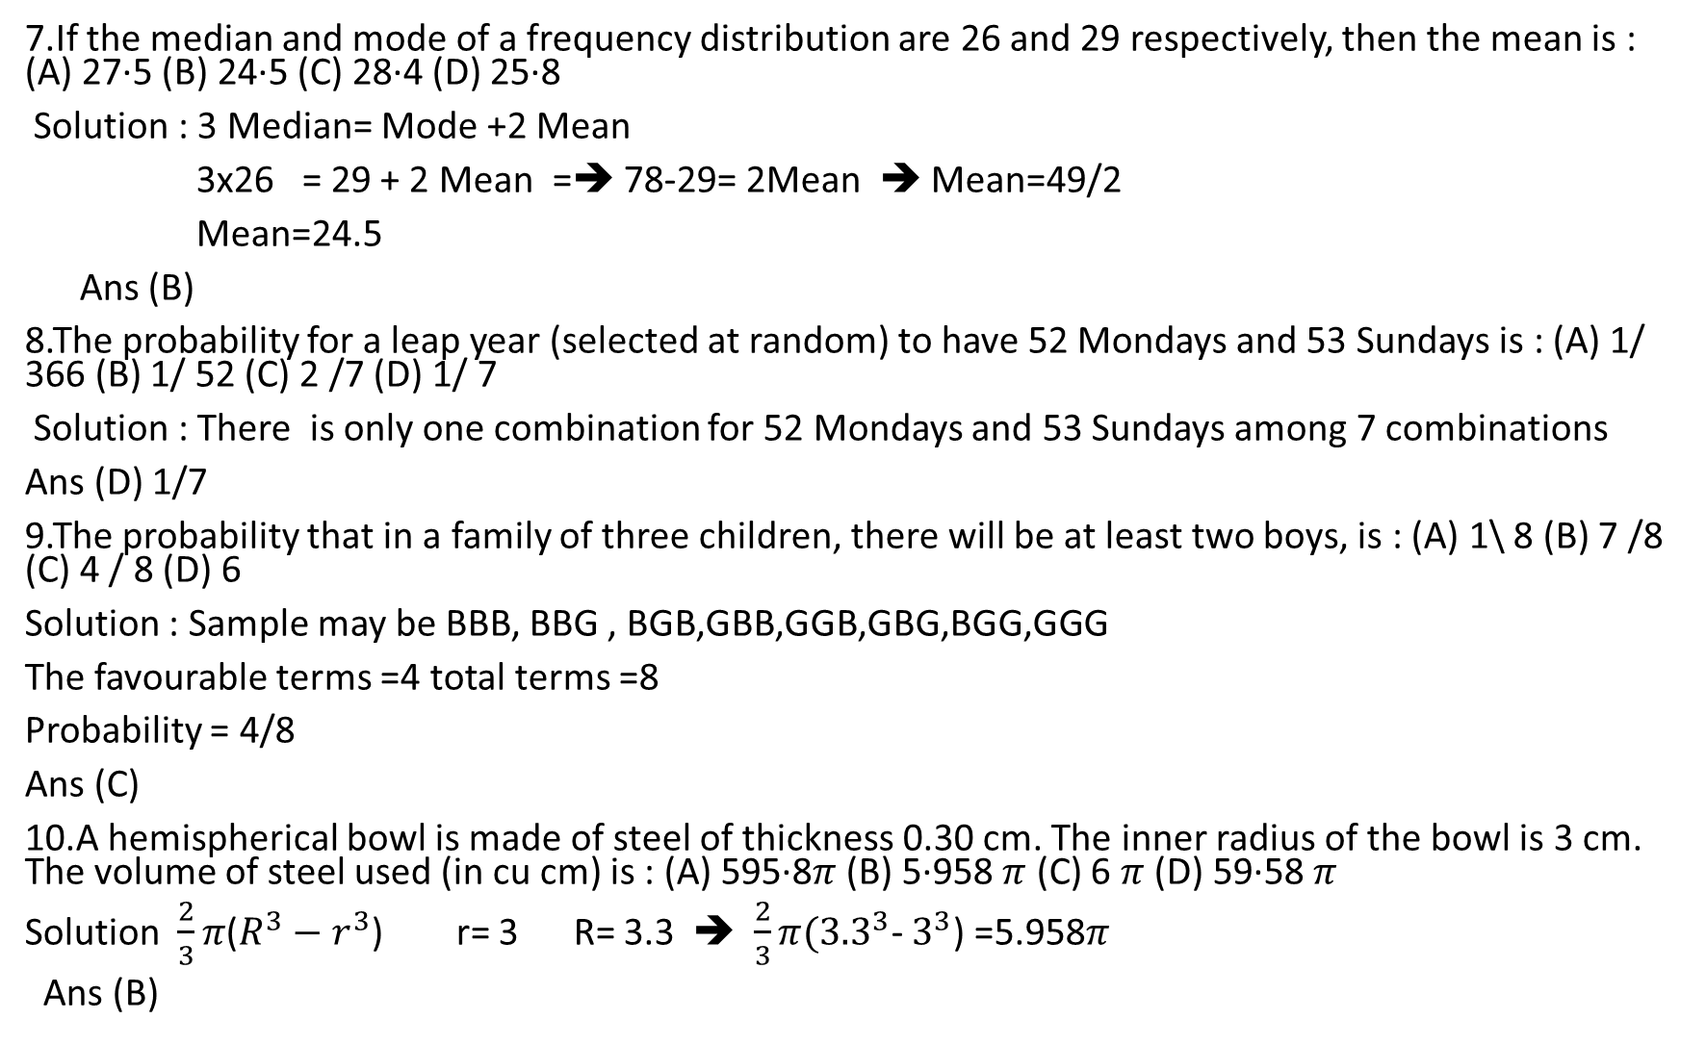
7.If the median and mode of a frequency distribution are 26 and 29 respectively, then the mean is : (A) 27·5 (B) 24·5 (C) 28·4 (D) 25·8
Solution : 3 Median= Mode +2 Mean
3x26 = 29 + 2 Mean =➔ 78-29= 2Mean ➔ Mean=49/2
Mean=24.5
Ans (B)
8.The probability for a leap year (selected at random) to have 52 Mondays and 53 Sundays is : (A) 1/ 366 (B) 1/ 52 (C) 2 /7 (D) 1/ 7
Solution : There is only one combination for 52 Mondays and 53 Sundays among 7 combinations
Ans (D) 1/7
9.The probability that in a family of three children, there will be at least two boys, is : (A) 1\ 8 (B) 7 /8 (C) 4 / 8 (D) 6
Solution : Sample may be BBB, BBG , BGB,GBB,GGB,GBG,BGG,GGG
The favourable terms =4 total terms =8
Probability = 4/8
Ans (C)
10.A hemispherical bowl is made of steel of thickness 0.30 cm. The inner radius of the bowl is 3 cm. The volume of steel used (in cu cm) is : (A) 595·8$π$ (B) 5·958 $π$ (C) 6 $π$ (D) 59·58 $π$
Solution $\frac{2}{3}π$($R^{3}−r^{3}$) r= 3 R= 3.3 ➔ $\frac{2}{3}π({3.3}^{3}$- $3^{3}$) =5.958$π$
Ans (B)

Slide 7
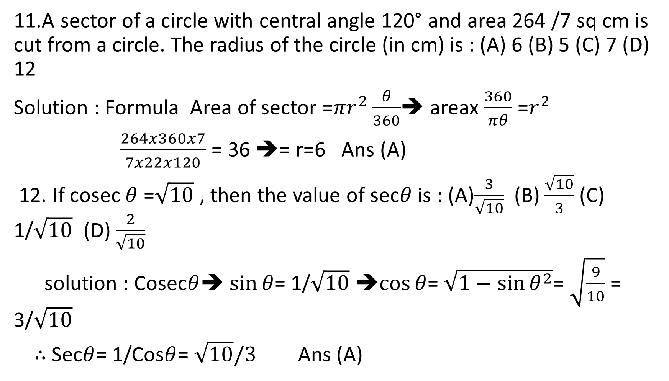
11.A sector of a circle with central angle 120° and area 264 /7 sq cm is cut from a circle. The radius of the circle (in cm) is : (A) 6 (B) 5 (C) 7 (D) 12
Solution : Formula Area of sector =${πr}^{2}\frac{θ}{360}$➔ areax $\frac{360}{πθ}$ =$r^{2}$
$\frac{264x360x7}{7x22x120}$ = 36 ➔= r=6 Ans (A)
12. If cosec $θ$ =$\sqrt{10}$ , then the value of sec$θ$ is : (A)$\frac{3}{\sqrt{10}}$ (B) $\frac{\sqrt{10}}{3}$ (C) 1/$\sqrt{10}$ (D) $\frac{2}{\sqrt{10}}$
solution : Cosec$θ$➔ $\sin{θ}$= 1/$\sqrt{10}$ ➔$\cos{θ}$= $\sqrt{1−{\sin{θ}}^{2}}$= $\sqrt{\frac{9}{10}}$ = 3/$\sqrt{10}$
$∴$Sec$θ$= 1/Cos$θ$= $\sqrt{10}/3$ Ans (A)

Slide 8

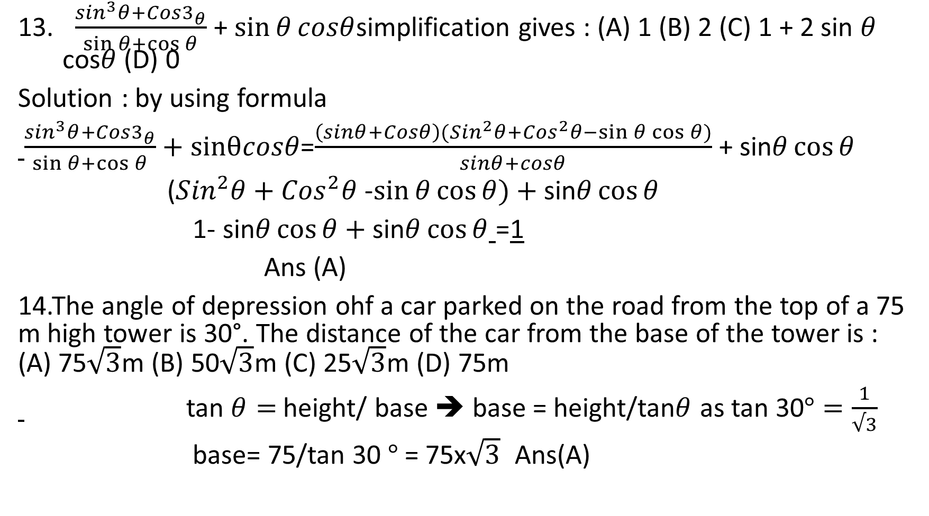
$\frac{\sin^{3}θ+Cos3_{θ}}{\sin{θ}+\cos{θ}}$ + $\sin{θ}cosθ$simplification gives : (A) 1 (B) 2 (C) 1 + 2 sin $θ$ cos$θ$ (D) 0
Solution : by using formula
$\frac{\sin^{3}θ+Cos3_{θ}}{\sin{θ}+\cos{θ}}+sinθcosθ$=$\frac{\left(sinθ+Cosθ\right)({Sin}^{2}θ+{Cos}^{2}θ−\sin{θ}\cos{θ)}}{sinθ+cosθ}$ + sin$θ\cos{θ}$
(${Sin}^{2}θ+{Cos}^{2}θ$ -$\sin{θ}\cos{θ})+$ sin$θ\cos{θ}$
1- sin$θ\cos{θ}+\text{sin}θ\cos{θ}$ =1
Ans (A)
14.The angle of depression ohf a car parked on the road from the top of a 75 m high tower is 30°. The distance of the car from the base of the tower is : (A) 75$\sqrt{3}$m (B) 50$\sqrt{3}$m (C) 25$\sqrt{3}$m (D) 75m
tan $θ=$height/ base ➔ base = height/tan$θ$ as tan 30$°=\frac{1}{√3}$
base= 75/tan 30 $°$ = 75x$\sqrt{3}$ Ans(A)

Slide 9



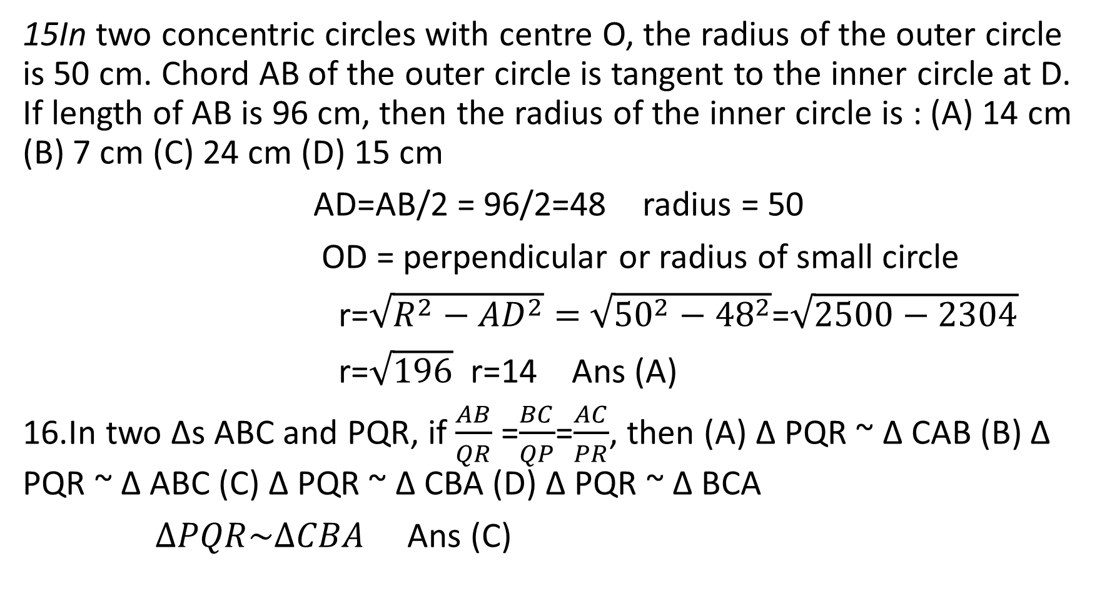
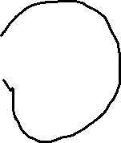

15In two concentric circles with centre O, the radius of the outer circle is 50 cm. Chord AB of the outer circle is tangent to the inner circle at D. If length of AB is 96 cm, then the radius of the inner circle is : (A) 14 cm (B) 7 cm (C) 24 cm (D) 15 cm
AD=AB/2 = 96/2=48 radius = 50
OD = perpendicular or radius of small circle
r=$\sqrt{R^{2}−{AD}^{2}}=$ $\sqrt{{50}^{2}−{48}^{2}}$=$\sqrt{2500−2304}$
r=$\sqrt{196}$ r=14 Ans (A)
16.In two ∆s ABC and PQR, if $\frac{AB}{QR}$ =$\frac{BC}{QP}$=$\frac{AC}{PR}$, then (A) ∆ PQR ~ ∆ CAB (B) ∆ PQR ~ ∆ ABC (C) ∆ PQR ~ ∆ CBA (D) ∆ PQR ~ ∆ BCA
$∆PQR\sim ∆CBA$ Ans (C)

Slide 10
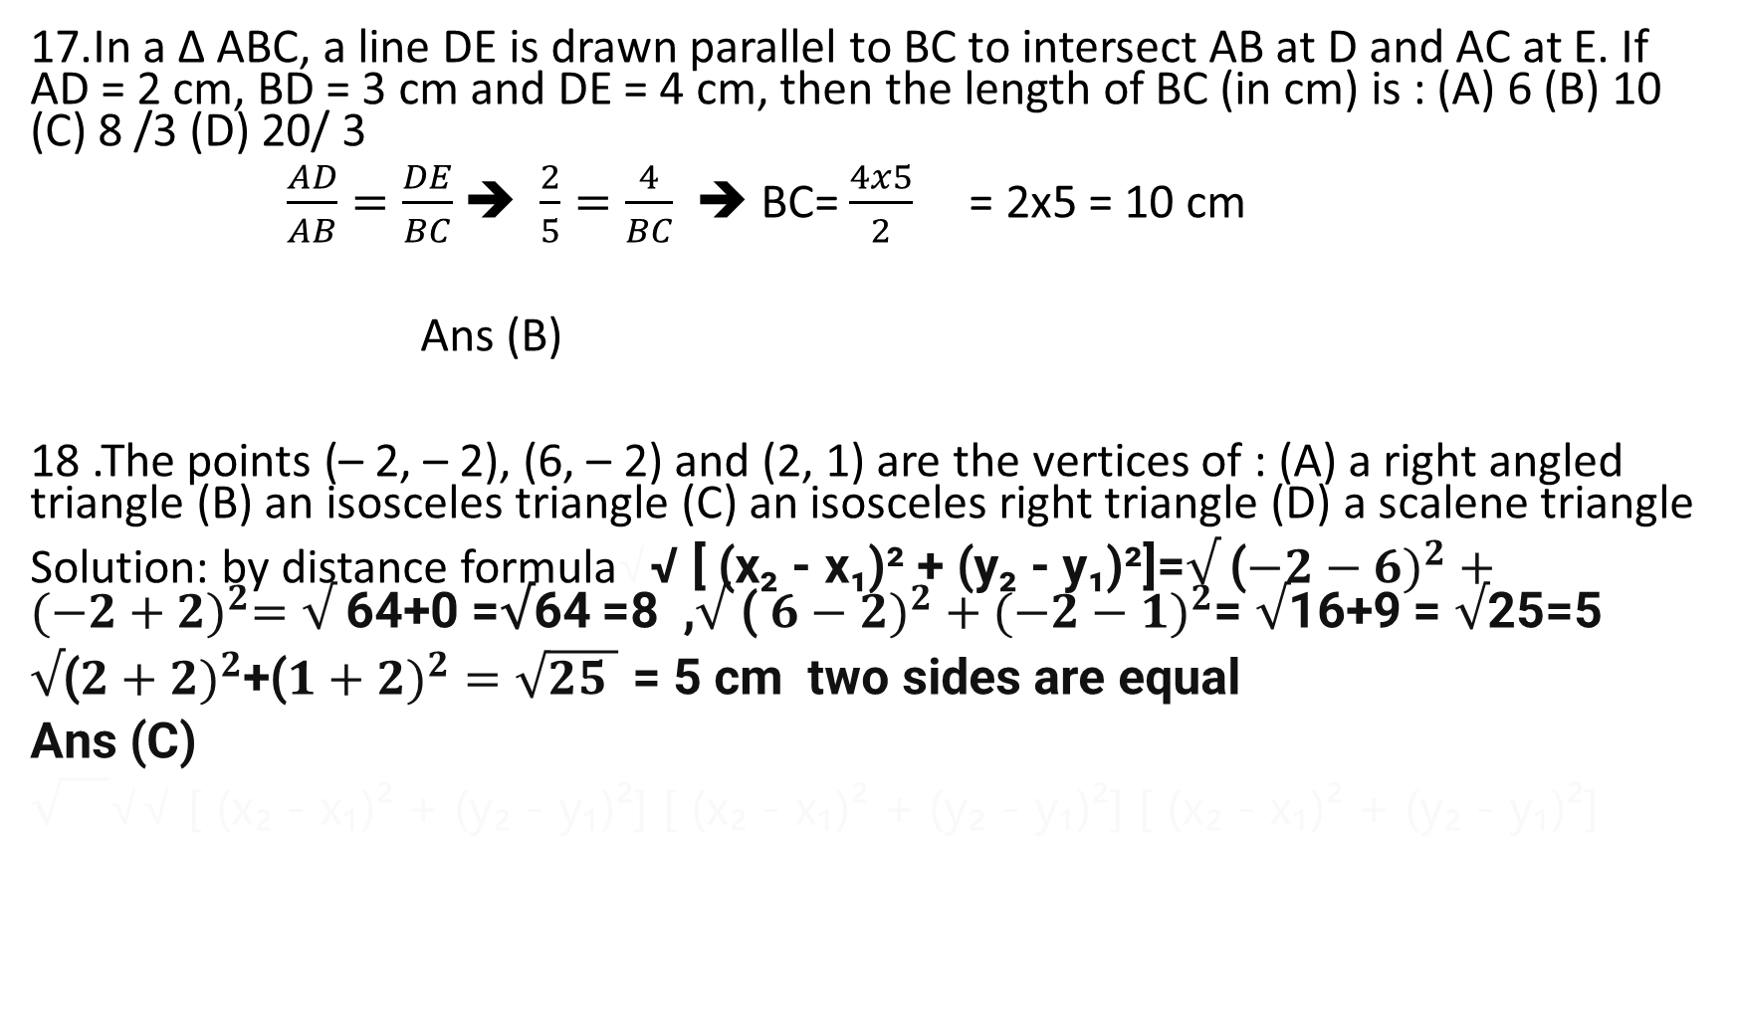
17.In a ∆ ABC, a line DE is drawn parallel to BC to intersect AB at D and AC at E. If AD = 2 cm, BD = 3 cm and DE = 4 cm, then the length of BC (in cm) is : (A) 6 (B) 10 (C) 8 /3 (D) 20/ 3
$\frac{AD}{AB}=\frac{DE}{BC}$ ➔ $\frac{2}{5}=\frac{4}{BC}$ ➔ BC= $\frac{4x5}{2}$ = 2x5 = 10 cm
Ans (B)
18 .The points (– 2, – 2), (6, – 2) and (2, 1) are the vertices of : (A) a right angled triangle (B) an isosceles triangle (C) an isosceles right triangle (D) a scalene triangle
Solution: by distance formula√√ [ (x₂ - x₁)² + (y₂ - y₁)²]=$√$ (${−2−6)}^{2}+({−2+2)}^{2}=√$64+0 =√64 =8 ,$√$ ( ${6−2)}^{2}+({−2−1)}^{2}$= $√$16+9 = $√$25=5
$√$(${2+2)}^{2}$+(${1+2)}^{2}=\sqrt{25 }$ = 5 cm two sides are equal
Ans (C)
√√ [ (x₂ - x₁)² + (y₂ - y₁)²] [ (x₂ - x₁)² + (y₂ - y₁)²] [ (x₂ - x₁)² + (y₂ - y₁)²]

Slide 11
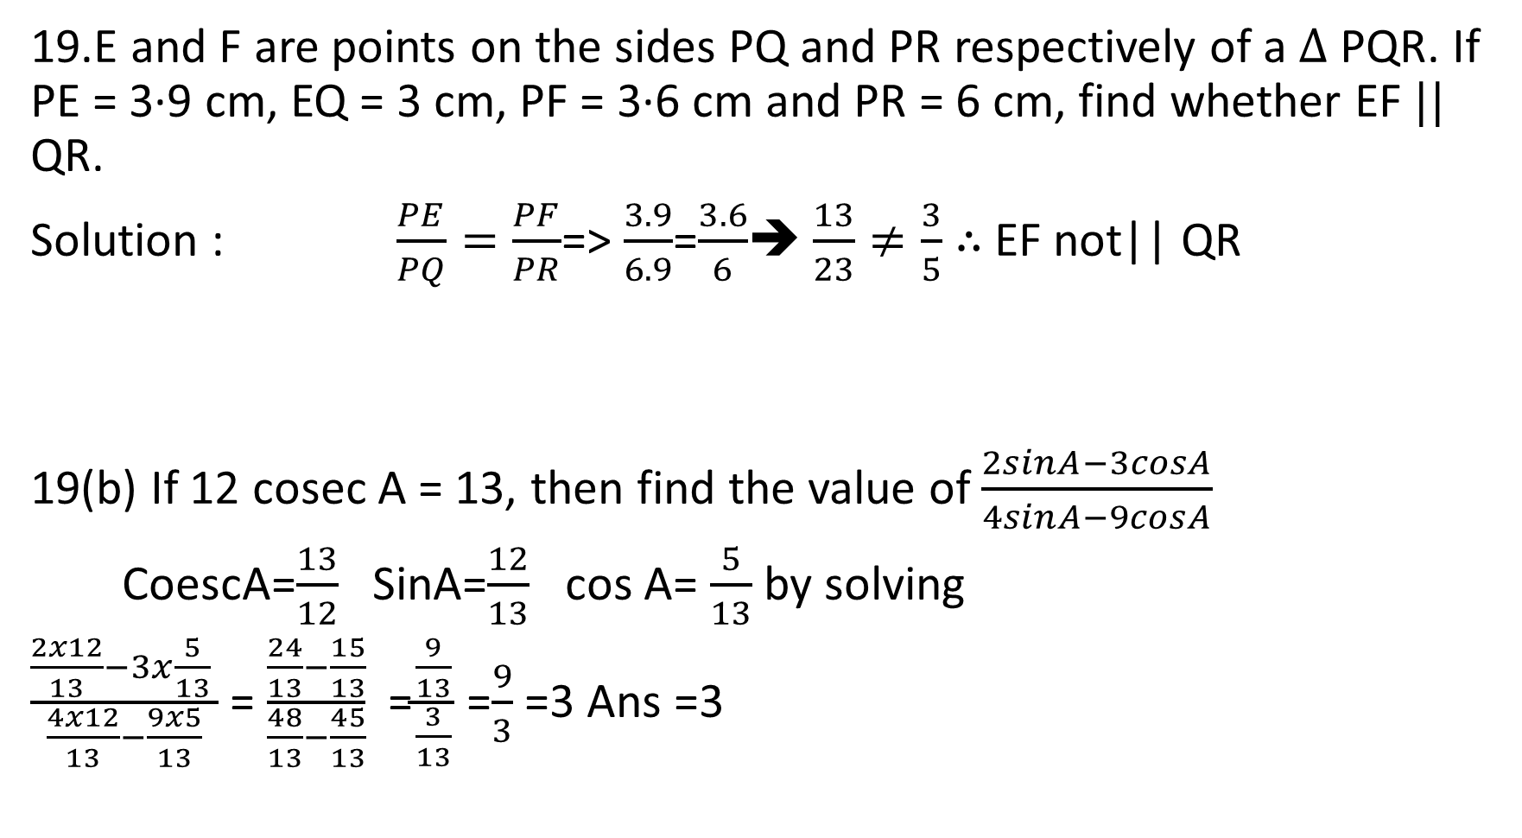


19.E and F are points on the sides PQ and PR respectively of a $∆$ PQR. If PE = 3·9 cm, EQ = 3 cm, PF = 3·6 cm and PR = 6 cm, find whether EF $||$ QR.
Solution : $\frac{PE}{PQ}=\frac{PF}{PR}$=> $\frac{3.9}{6.9}$=$\frac{3.6}{6}$➔ $\frac{13}{23}≠\frac{3}{5}$ $∴$EF not|| QR
19(b) If 12 cosec A = 13, then find the value of $\frac{2sinA−3cosA}{4sinA−9cosA}$
CoescA=$\frac{13}{12}$ SinA=$\frac{12}{13}$ cos A= $\frac{5}{13}$ by solving
$\frac{\frac{2x12}{13}−3x\frac{5}{13} }{\frac{4x12}{13}−\frac{9x5}{13}}$ = $\frac{\frac{24}{13}−\frac{15}{13}}{\frac{48}{13}−\frac{45}{13}}$ =$\frac{\frac{9}{13}}{\frac{3}{13}}$ =$\frac{9}{3}$ =3 Ans =3

Slide 12
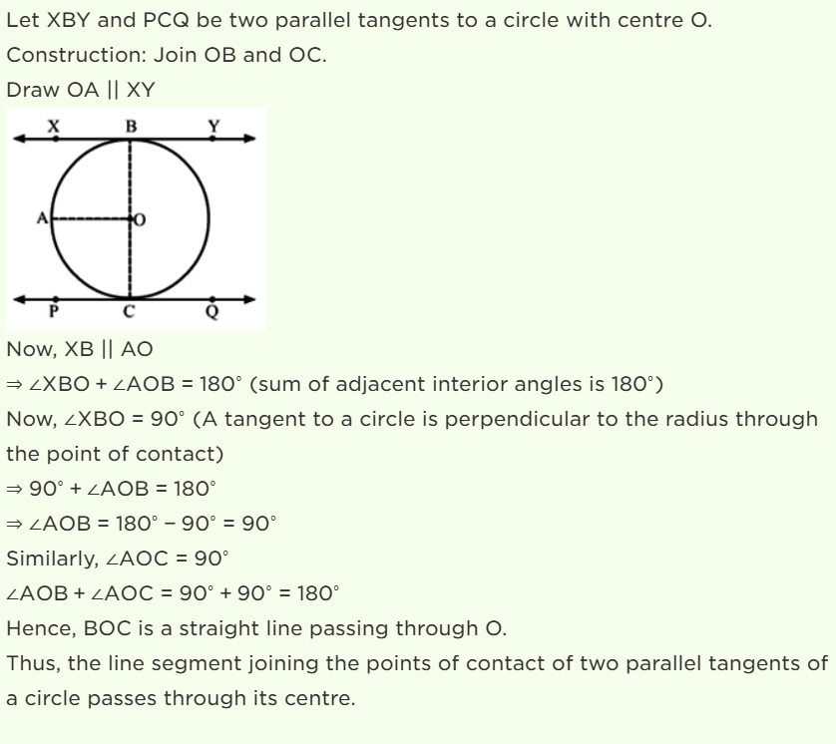
20, Prove that the line segment joining the points of contact of two parallel tangents to a circle passes through its centre

Slide 13
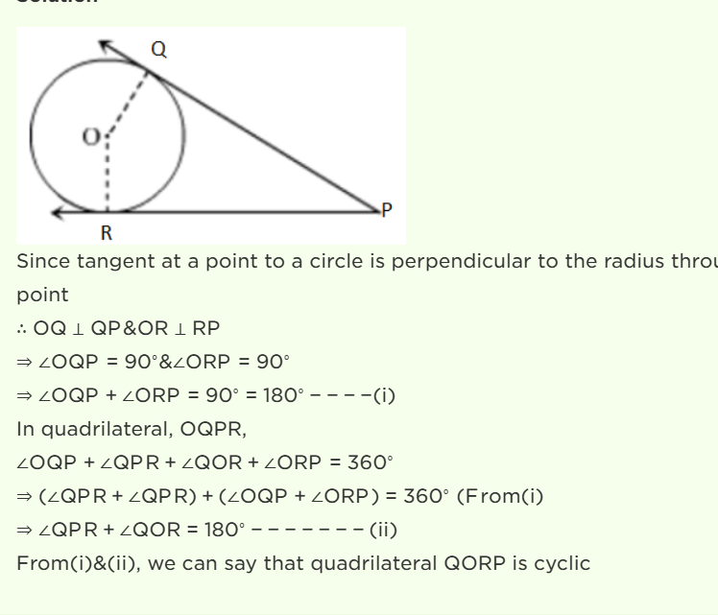
21.Two tangents PQ and PR are drawn from an external point P to a circle with centre O. Prove that QORP is a cyclic quadrilateral.

Slide 14
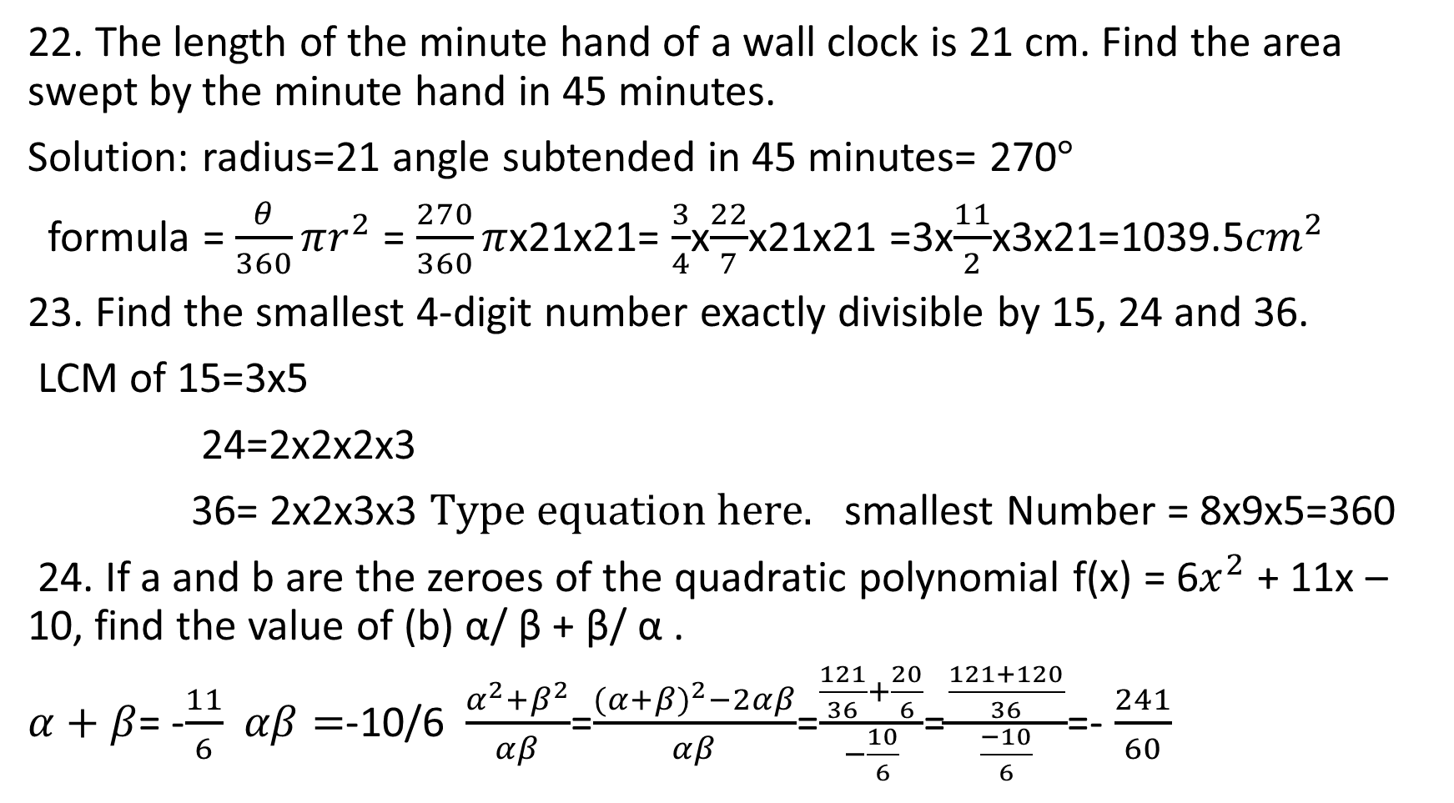
22. The length of the minute hand of a wall clock is 21 cm. Find the area swept by the minute hand in 45 minutes.
Solution: radius=21 angle subtended in 45 minutes= 270$°$
formula = $\frac{θ}{360}πr^{2}$ = $\frac{270}{360}π$x21x21= $\frac{3}{4}$x$\frac{22}{7}$x21x21 =3x$\frac{11}{2}$x3x21=1039.5${cm}^{2}$
23. Find the smallest 4-digit number exactly divisible by 15, 24 and 36.
LCM of 15=3x5
24=2x2x2x3
36= 2x2x3x3 smallest Number = 8x9x5=360
24. If a and b are the zeroes of the quadratic polynomial f(x) = 6$x^{2}$ + 11x – 10, find the value of (b) α/ β + β/ α .
$α+β$= -$\frac{11}{6}$ $αβ=$-10/6 $\frac{α^{2}{+β}^{2}}{αβ}$=$\frac{{(α+β)}^{2}−2αβ}{αβ}$=$\frac{\frac{121}{36}+\frac{20}{6}}{−\frac{10}{6}}$=$\frac{\frac{121+120}{36}}{\frac{−10}{6}}$=- $\frac{241}{60}$

Slide 15
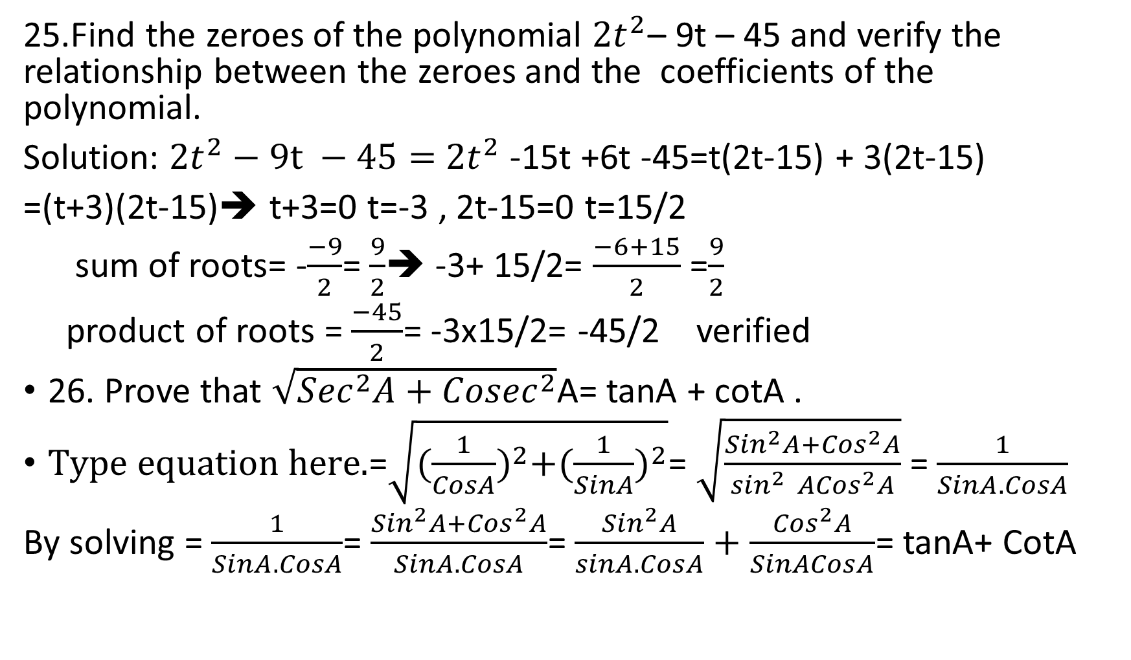
25.Find the zeroes of the polynomial ${2t}^{2}$– 9t – 45 and verify the relationship between the zeroes and the coefficients of the polynomial.
Solution: ${2t}^{2}−9t −45=$ ${2t}^{2}$ -15t +6t -45=t(2t-15) + 3(2t-15)
=(t+3)(2t-15)➔ t+3=0 t=-3 , 2t-15=0 t=15/2
sum of roots= -$\frac{−9}{2}$= $\frac{9}{2}$➔ -3+ 15/2= $\frac{−6+15}{2}$ =$\frac{9}{2}$
product of roots = $\frac{−45}{2}$= -3x15/2= -45/2 verified
26. Prove that $\sqrt{{Sec}^{2}A+{Cosec}^{2}}$A= tanA + cotA .
=$\sqrt{{(\frac{1}{CosA})}^{2}+({\frac{1}{SinA})}^{2}}$= $\sqrt{\frac{{Sin}^{2}A+{Cos}^{2}A}{\sin^{2 }{ACos}^{2}A}}$ = $\frac{1}{SinA.CosA}$
By solving = $\frac{1}{SinA.CosA}$= $\frac{{Sin}^{2}A+{Cos}^{2}A}{SinA.CosA}$= $\frac{{Sin}^{2}A}{sinA.CosA}+\frac{{Cos}^{2}A}{SinACosA}$= tanA+ CotA

Slide 16
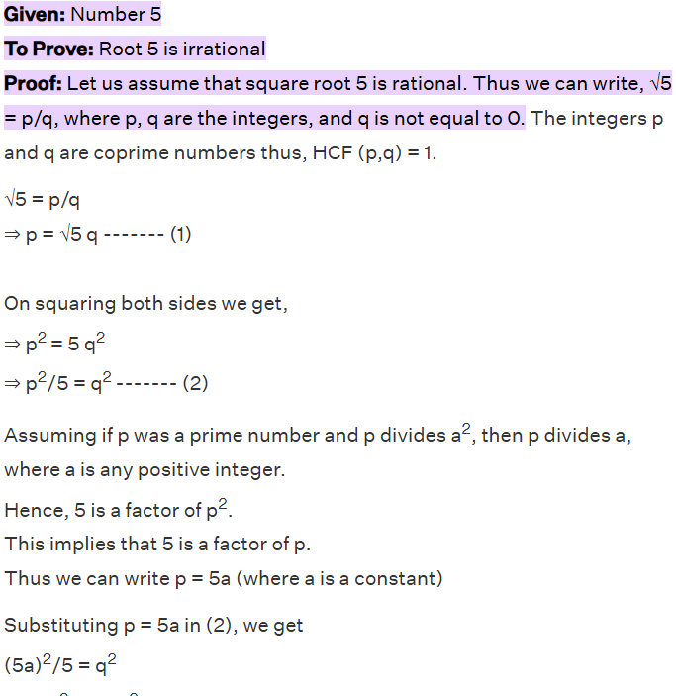
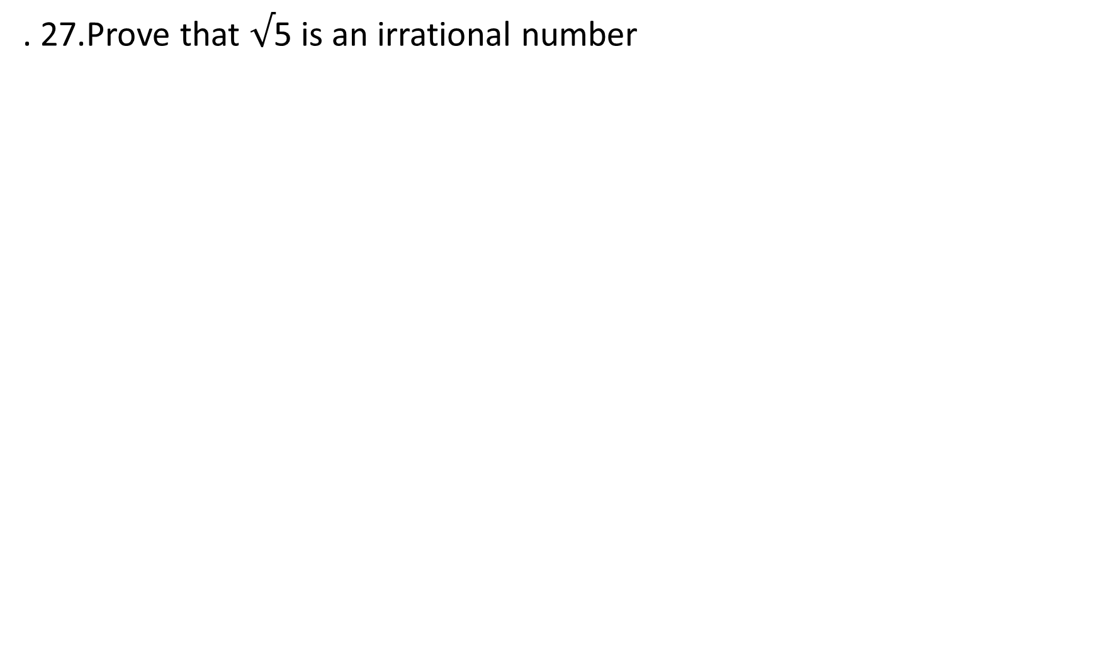
. 27.Prove that $√$5 is an irrational number
a² = q²/5 ------- (3)
Hence 5 is a factor of q (from 3)
(2) indicates that 5 is a factor of p and (3) indicates that 5 is a factor of q. This contradicts our assumption that √5 = p/q.
Therefore, the square root of 5 is irrational.

Slide 17
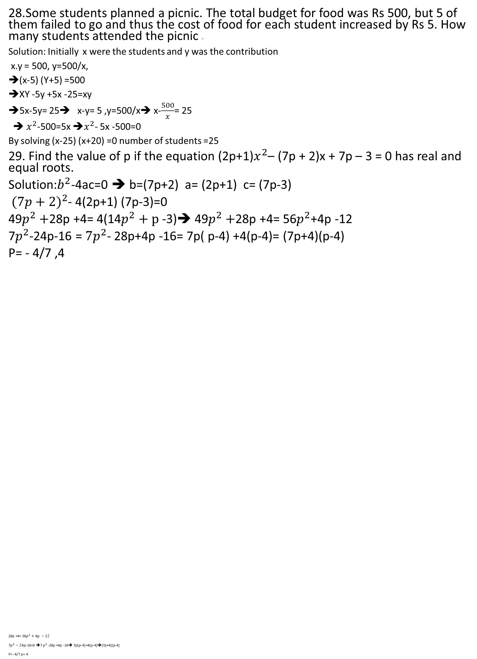
28.Some students planned a picnic. The total budget for food was Rs 500, but 5 of them failed to go and thus the cost of food for each student increased by Rs 5. How many students attended the picnic ?
Solution: Initially x were the students and y was the contribution
x.y = 500, y=500/x,
(x-5) (Y+5) =500
XY -5y +5x -25=xy
➔5x-5y= 25➔ x-y= 5 ,y=500/x➔ x-$\frac{500}{x}$= 25
➔ $x^{2}$-500=5x ➔$x^{2}$- 5x -500=0
By solving (x-25) (x+20) =0 number of students =25
29. Find the value of p if the equation (2p+1)$x^{2}$– (7p + 2)x + 7p – 3 = 0 has real and equal roots.
Solution:$b^{2}$-4ac=0 ➔ b=(7p+2) a= (2p+1) c= (7p-3)
${(7p+2)}^{2}$- 4(2p+1) (7p-3)=0
49$p^{2}+$28p +4= 4(14$p^{2}+p$ -3)➔ 49$p^{2}+$28p +4= 56$p^{2}$+4p -12
7$p^{2}$-24p-16 = ${7p}^{2}$- 28p+4p -16= 7p( p-4) +4(p-4)= (7p+4)(p-4)
P= - 4/7 ,4
28p +4= 56$p^{2}+4p −12$
7$p^{2}−24$p-16=0 ➔7 $p^{2 }$-28p +4p -16➔ 7p(p-4)+4(p-4)➔(7p+4)(p-4)
P= -4/7 p= 4

