Slide 1
Topper’s Home
Important Question
Science X
toppershome.online

Slide 2
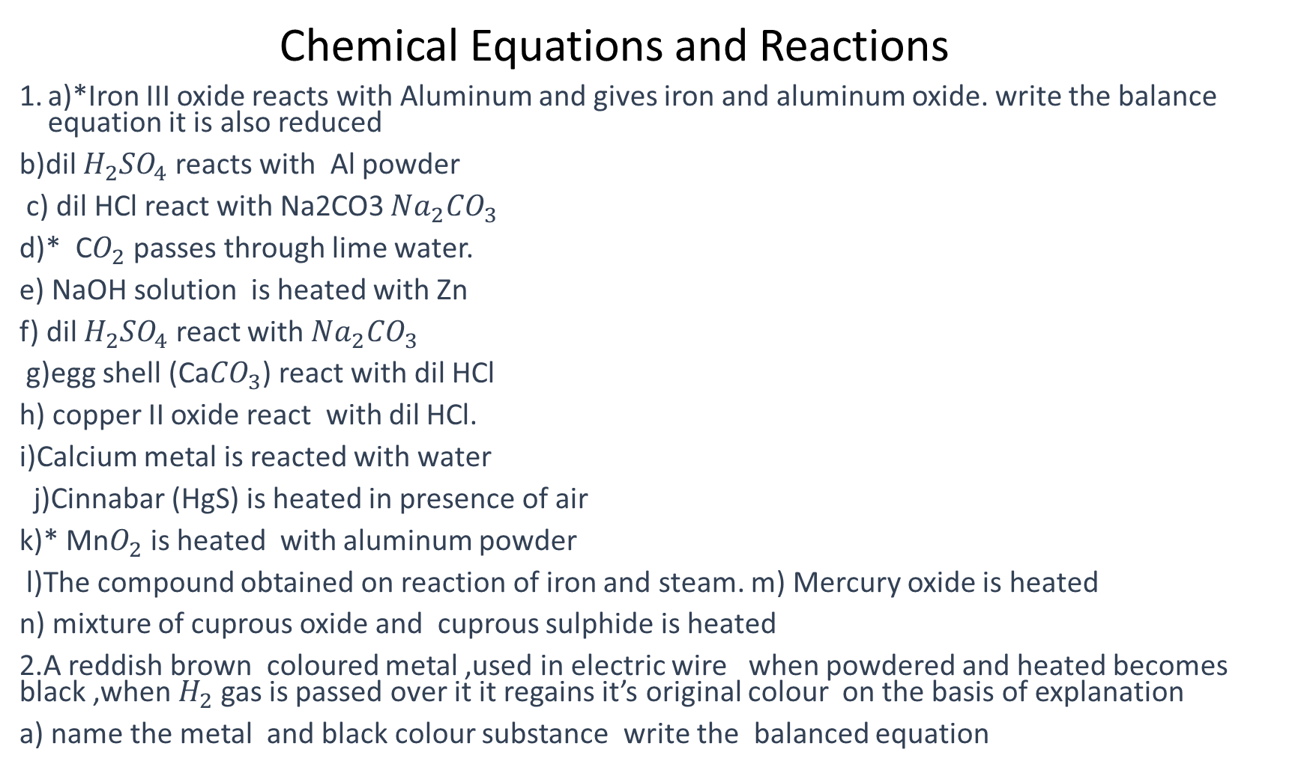
Chemical Equations and Reactions
a)*Iron III oxide reacts with Aluminum and gives iron and aluminum oxide. write the balance equation it is also reduced
b)dil $H_{2}{SO}_{4}$ reacts with Al powder
c) dil HCl react with Na2CO3 ${Na}_{2}{CO}_{3}$
d)* C$O_{2}$ passes through lime water.
e) NaOH solution is heated with Zn
f) dil $H_{2}{SO}_{4}$ react with ${Na}_{2}{CO}_{3}$
g)egg shell (Ca${CO}_{3}$) react with dil HCl
h) copper II oxide react with dil HCl.
i)Calcium metal is reacted with water
j)Cinnabar (HgS) is heated in presence of air
k)* Mn$O_{2}$ is heated with aluminum powder
l)The compound obtained on reaction of iron and steam. m) Mercury oxide is heated
n) mixture of cuprous oxide and cuprous sulphide is heated
2.A reddish brown coloured metal ,used in electric wire when powdered and heated becomes black ,when $H_{2}$ gas is passed over it it regains it’s original colour on the basis of explanation
a) name the metal and black colour substance write the balanced equation

Slide 3
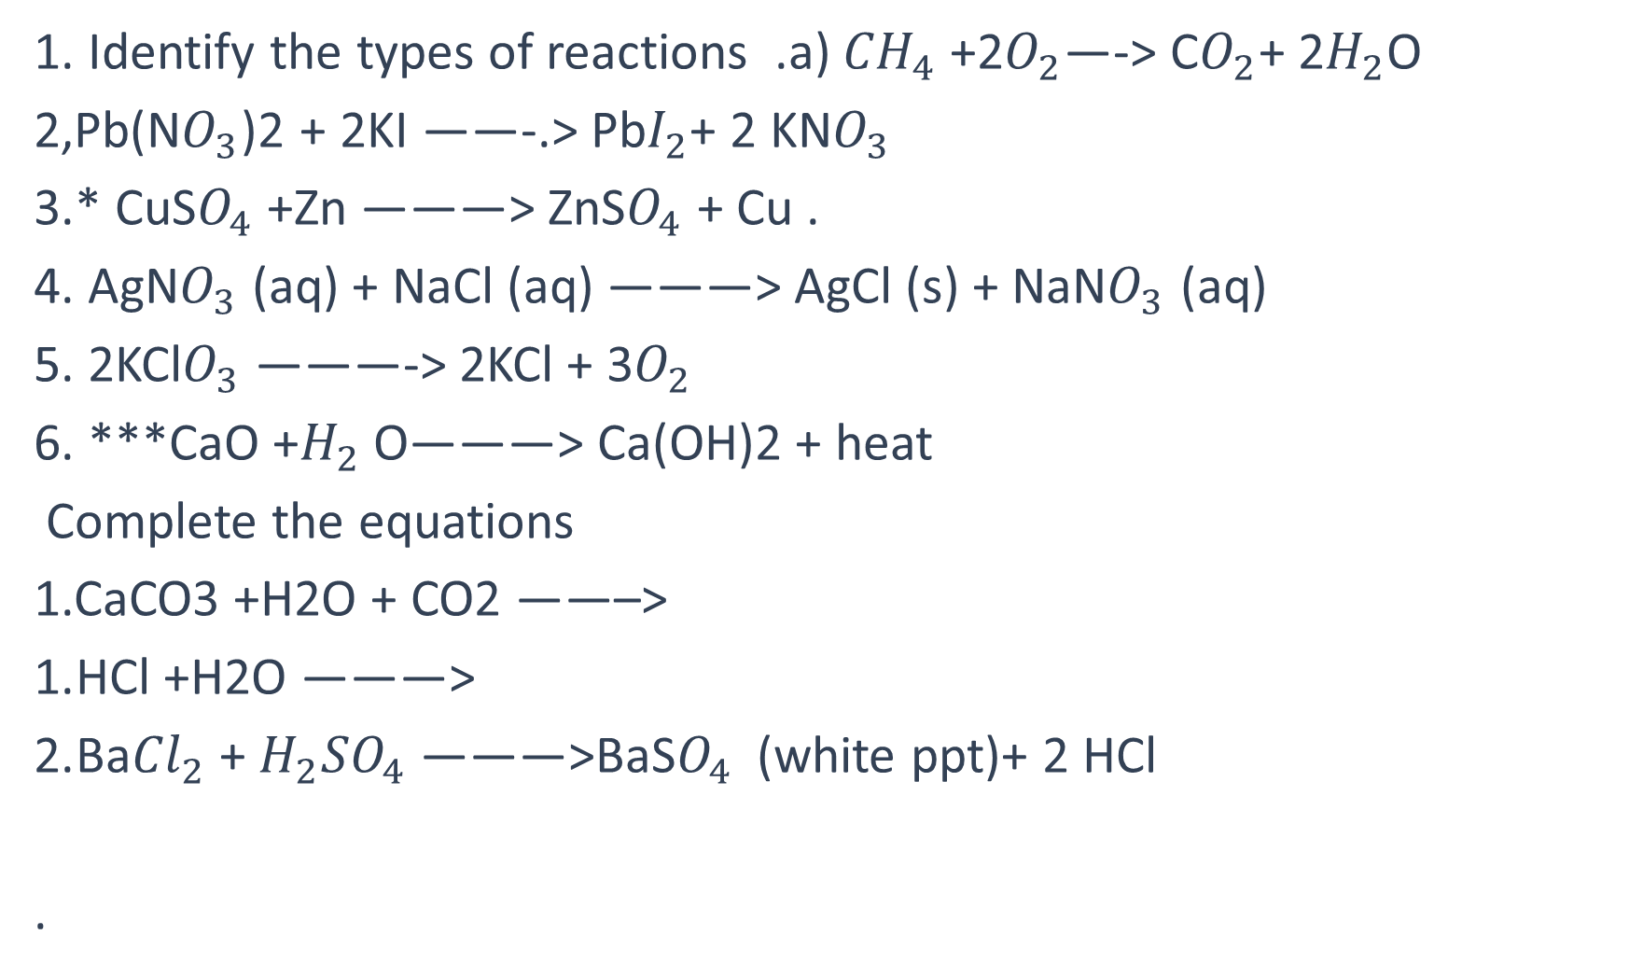
Identify the types of reactions .a) ${CH}_{4}$ +2$O_{2}$—-> C$O_{2}$+ 2$H_{2}$O
2,Pb(N$O_{3}$)2 + 2KI ——-.> Pb$I_{2}$+ 2 KN$O_{3}$
3.* CuS$O_{4}$ +Zn ———> ZnS$O_{4}$ + Cu .
4. AgN$O_{3}$ (aq) + NaCl (aq) ———> AgCl (s) + NaN$O_{3}$ (aq)
5. 2KCl$O_{3}$ ———-> 2KCl + 3$O_{2}$
6. ***CaO +$H_{2}$ O———> Ca(OH)2 + heat
Complete the equations
1.CaCO3 +H2O + CO2 ——–>
HCl +H2O ———>
Ba${Cl}_{2}$ + $H_{2}{SO}_{4}$ ———>BaS$O_{4}$ (white ppt)+ 2 HCl
.

Slide 4
3,why the blue colour of copper sulphate disappears when some aluminum power is added to it .
4.When calcium oxide is taken in container and water is added to it slowly state two observation made the experiment and write the balanced equation a) kind of sound b) exothermic / endothermic reaction. (2024)
5.* when H2 gas is passed over heated copper II oxide , copper and steam is formed write the equation write the substance oxidised and reduced .
6.A student dropped a few pieces of marble in dil HCl in the test tube the gas evolved passed through lime water .write the balanced equation

Slide 5
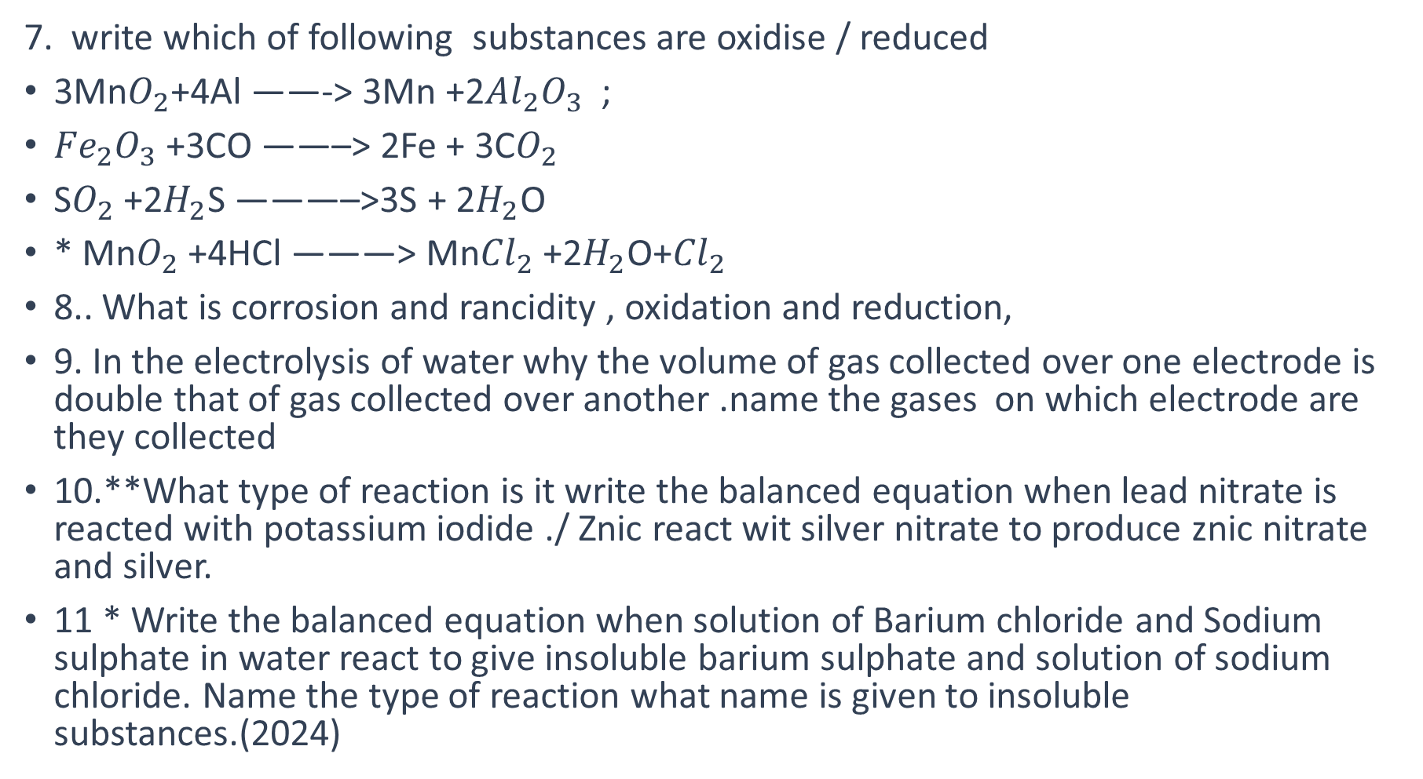
7. write which of following substances are oxidise / reduced
3Mn$O_{2}$+4Al ——-> 3Mn +2${Al}_{2}O_{3}$ ;
${Fe}_{2}O_{3}$ +3CO ——–> 2Fe + 3C$O_{2}$
S$O_{2}$ +2$H_{2}$S ———–>3S + 2$H_{2}$O
* Mn$O_{2}$ +4HCl ———> Mn${Cl}_{2}$ +2$H_{2}$O+${Cl}_{2}$
8.. What is corrosion and rancidity , oxidation and reduction,
9. In the electrolysis of water why the volume of gas collected over one electrode is double that of gas collected over another .name the gases on which electrode are they collected
10.**What type of reaction is it write the balanced equation when lead nitrate is reacted with potassium iodide ./ Znic react wit silver nitrate to produce znic nitrate and silver.
11 * Write the balanced equation when solution of Barium chloride and Sodium sulphate in water react to give insoluble barium sulphate and solution of sodium chloride. Name the type of reaction what name is given to insoluble substances.(2024)

Slide 6
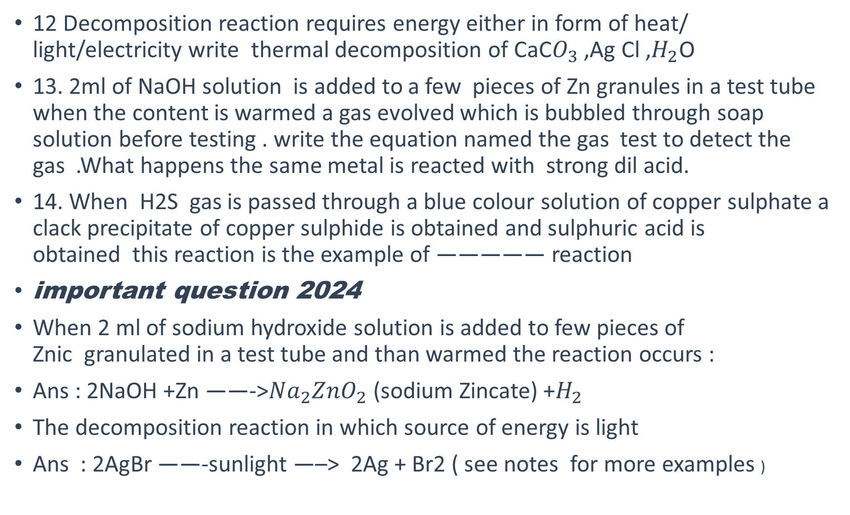
12 Decomposition reaction requires energy either in form of heat/ light/electricity write thermal decomposition of CaC$O_{3}$ ,Ag Cl ,$H_{2}$O
13. 2ml of NaOH solution is added to a few pieces of Zn granules in a test tube when the content is warmed a gas evolved which is bubbled through soap solution before testing . write the equation named the gas test to detect the gas .What happens the same metal is reacted with strong dil acid.
14. When H2S gas is passed through a blue colour solution of copper sulphate a clack precipitate of copper sulphide is obtained and sulphuric acid is obtained this reaction is the example of ————— reaction
important question 2024
When 2 ml of sodium hydroxide solution is added to few pieces of Znic granulated in a test tube and than warmed the reaction occurs :
Ans : 2NaOH +Zn ——->${Na}_{2}{ZnO}_{2}$ (sodium Zincate) +$H_{2}$
The decomposition reaction in which source of energy is light
Ans : 2AgBr ——-sunlight —–> 2Ag + Br2 ( see notes for more examples )

Slide 7
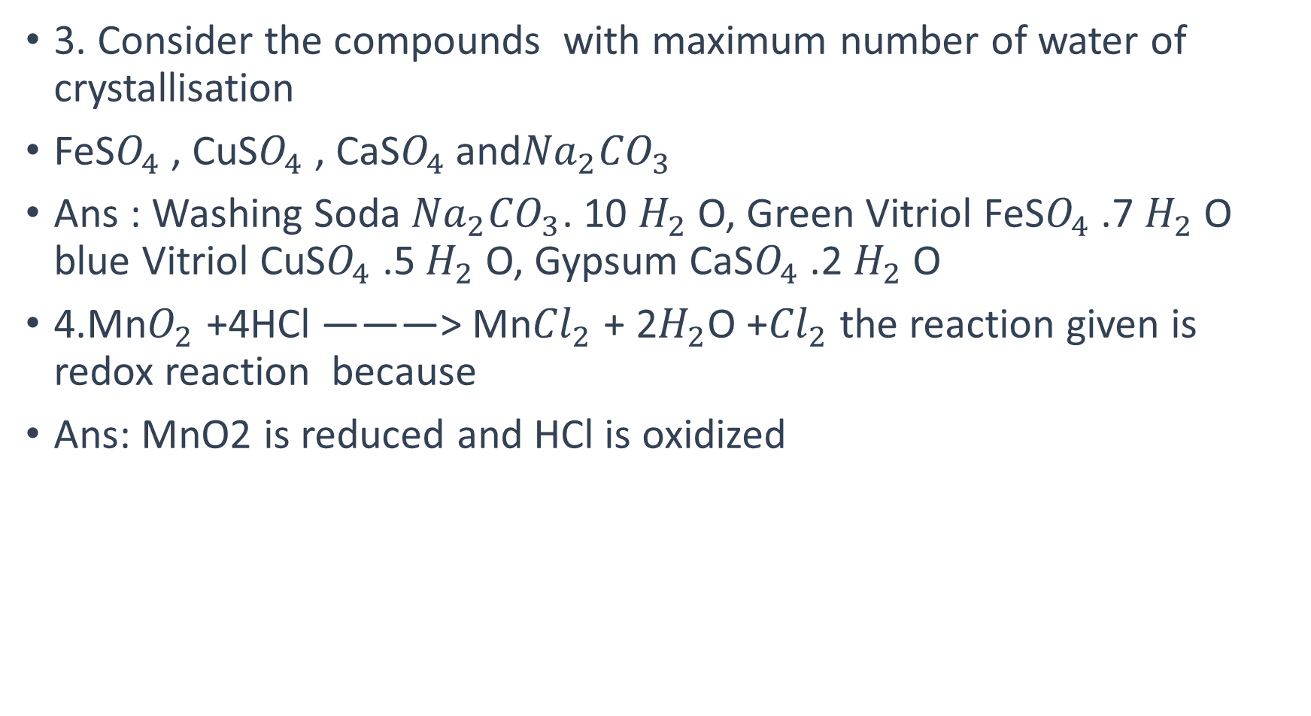
3. Consider the compounds with maximum number of water of crystallisation
FeS$O_{4}$ , CuS$O_{4}$ , CaS$O_{4}$ and${Na}_{2}{CO}_{3}$
Ans : Washing Soda ${Na}_{2}{CO}_{3}$. 10 $H_{2}$ O, Green Vitriol FeS$O_{4}$ .7 $H_{2}$ O blue Vitriol CuS$O_{4}$ .5 $H_{2}$ O, Gypsum CaS$O_{4}$ .2 $H_{2}$ O
4.Mn$O_{2}$ +4HCl ———> Mn${Cl}_{2}$ + 2$H_{2}$O +${Cl}_{2}$ the reaction given is redox reaction because
Ans: MnO2 is reduced and HCl is oxidized

