Slide 1
Electricity and Magnetic Effects
Important Questions
Science Class x
toppershome.online

Slide 2
Electricity
A apiece of wire of resistance R is cut into five equal parts These parts are then connected in parallel than equivalent resistance
The electric bulb is rated 220v and 100 w when it is operated on 110 v than the power consumed
The conducting wires of the same material and of equal length and equal diameter are first connected in series and then parallel in the circuit across the same potential difference find the ratio between two equivalent resistances .
How is voltmeter connected in circuit ?
A copper wire of diameter 0.5mm resistivity of 0.0000016 ohm -m what should be the length of wire to make the resistance of 10 ohm . ? When a 12 volt battery is connected to the unknown resistance give the current of 2.5mA find the value of resistance.
If the battery of 9V is connected to .2 ohm, .3 ohm , .4ohm, .5 ohm and 12 ohm resistance connected in series find the current flowing through 12 ohm resistance?
How many 176 ohm resistances are required to maintain the current of 5A through 220V. There three resistances of 6 ohm each how will you connect the resistance to give 9 ohm or 4 ohm equivalent resistance. How many lamps to be connected of 40w,220 v such that5A current flows through it.
How many bulbs of 220V and 10W be connected in parallel to 220V mains to produce the current of 5A. A hot plate having the 2 resistance of24 ohm each can be used separately, /series / parallel is connected 220 mains find the current in all cases
Compare the power in 2 ohm resistor each case a) 6V battery in series with 1 ohm , ohm resistors b) 4V battery in parallel with 12 ohm and 2ohm resistors
What is the current flowing through the circuit when two bulb of 100w 220v and 60 w 220v connected parallel. What is the energy consumed if 250 w TV used fir 1 hr and toasters of 120 w used for 30minutes

Slide 3
10. Give reasons a) tungsten is used for filament in bulb .b) Electric iron ,bread toaster has conductors of alloy c) series arrangement of circuit is not used in domestic wiring d) relation of resistance and aera of cross-section of conductor e) copper /aluminum wires are used in electricity transmission. f) relation of power and potential difference. g) Electric bulb is filled with which inactive gases h) fuse is connected in live wire
11. A charge of 15 coulomb flows in one minute find the current flowing . What is the cost @ Rs 3/unit when heater of 800w is operated for 6hrs/day for 3 days. Find the equivalent resistance when 10 ohm,15 ohm 5 ohm resistance are connected in parallel Draw the graph of ohm’s law and explain it.
12.Nichrome wire of length of l of radius r has resistance of 10 ohm how is resistance changes when length of wire is made double or if radius is made doubled.
13.Three resistors 5 ohm, 10 ohm , 15 ohm is connected in series with the battery of 30v draw the circuit with ammeter and voltmeter find the current passing in 1o ohm .
14.The electric iron rated 840 w -360 w if connected to 220v find the resistance in minimum and maximum conditions.
15. A bulb of200v ,100w calculate the resistance of bulb if 5 such bulbs are connected for 4 hrs find the unit consumed and cost @rs 4/unit. Calculate the aera of cross-section of wire of length 625mm ,resistance 4 ohm and resistivity of 0.00000048 ohm -meter.
16 An electric lamp is connected to 4 ohm resistance in series such that current flowing is.25 A through battery of 6 v.
17. Drive the expression of combination of resistance in series and parallel. Two lamps of 40 w 220v ,and 100w 220v connected in parallel calculate the resistance, current and energy of circuit.
18 Two resistances of 10 ohm , 15 ohm is connected with 12 v battery find the minimum and maximum current flowing indifferent conditions .
19 What is the difference between AC and DC circuit ,write their frequency. and graph

Slide 4
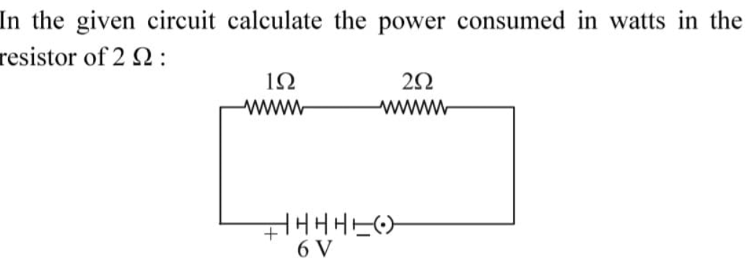
20..Write three important features of domestic electric supply lines with reference voltage, wire colour , and combination of circuit , what is overloading and short-circuiting .
21.
22..i)Define electric power .write the relation of V and R . The electric is design to work at 220 volt, it consumes 11 units of energy in 5 hrs than find i) power rating ii) Electric current drawn iii) Resistance (2024)

Slide 5
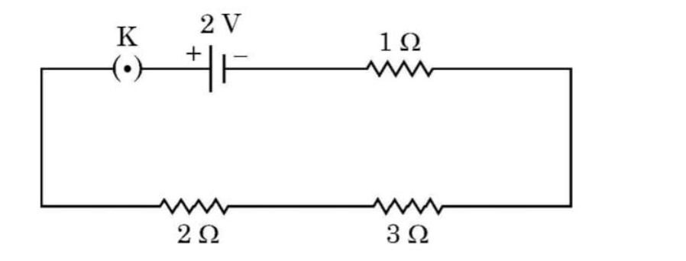
23. Drive the expression of resistivity and it's SI unit,the resistance of 3 meter long wire is 60Ω if cross section aera is 4x10^-7 m² calculate resistivity , state how resistivity affected if length of wire is made double (2024) iv) use Ohm's law to determine the potential difference across of 3Ω resistance as shown.Draw a graph of 3 different Resistance of 2 , 3, 4 ohms showing their slopes.

Slide 6
Magnetic Effects
where is the magnetic field near a long straight wire ? What is the phenomenon of electromagnetic induction?
Name device used for producing electric-current is generator/motor/ galvanometer.
What is the main difference between AC generator and DC generator.
What happens about the current at the time of short circuiting. when does it take place. What are three sources of magnetic fields.?
How does a solenoid behave like magnet? How the North and south pole is determined in it?
Draw a label diagram of electric motor . Explain the principle of motor and it's working and uses .
A coil of insulated copper wire is connected to galvanometer what happens to when bar magnet is i) pushed into the coil ii) withdrawn from inside the coil iii) remain stationary in coil
State the rule by which the direction of magnetic field is determine i) The magnetic field produced around a straight current carrying conductor ii)Force experienced by the current carrying straight conductor placed in magnetic field which is perpendicular to it. iii) Current induced in coil due to rotation in magnetic field.
Two circular coils A and B are placed close to each d if the current in coil flows in A is changed will the be any effect on B.
Explain the principles of generator with it's working and diagram

Slide 7
10.What is the angle between current and magnetic field for maximum current in straight current carrying conductor ? Explain Fleming right hand rule.
11.List the properties of magnetic lines of forces.
12. Draw magnetic field lines produced around a current carrying straight conductor passing through cardboard .How will the strength of magnetic field changes ,when the point where magnetic field is to be determined is moved away from the conductor. or when current flowing increases
13.State Maxwell right hand thumb rule ? Magnetic field lines close to the axis of current carrying loop as we move away from the center of loop we observe the lines keep on diverging why it is so.
14.Explain the effect of magnetic field produced at point in a current carrying circular coil when a)amount of current is increased b)distance form the coil increase c)increase the number of turns.
15.Show that a current carrying conductor experiences the force when placed in magnetic field.
16.Draw the magnetic field lines of bar magnet why two l magnet lines do not intersect each other
17.The two coils P and Q are wounded over the same iron core Coil p is connected to a battery and key and coil Q is connected to galvanometer what happens) current in coil P started by closed by . ii) Current continues to flow in coil P iii) Current in coil P is stopped give reasons

Slide 8
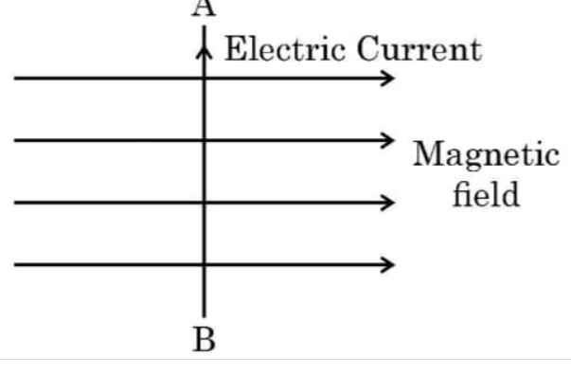
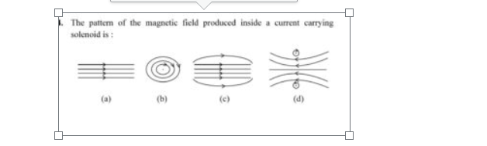
18,why do magnet field lines do not intersect each other ?(2024)ii) Draw the magnet field lines represented . State Fleming's left rule explain the direction of force if the current flows through AB placed in uniform magnet field What will happen when electron enters the same field along the direction of AB
19. 2024

