Slide 1
History Class X
Important Questions
toppershome.online

Slide 2
Rise of nationalism in Europe.
Note : questions in different colour are 2024 question
What was the main aim of French Revolutionaries ? what were the concentration camps ?
Which treaty recognised Greece as independent state when did it took place ?
Which event in Europe moblised the nationalist feeling among the educated and elites between 1830 – 1848 **
What was the aim of revolutionaries of Europe during the year 1815.
Whi remarked ” When France sneezes the rest of Europe catches cold”
Who was proclaimed German Emperor in the ceremony held at Versailles in January 1871 ? Who was proclaimed the king of United Italy 1861?
The artist Frederic Sorrieu in his painting who visualised ‘society made up of Democratic and Social Republic” belongs to which country ?
What is the meaning of Nationalism emerged in 19th century ? What is Utopian society ? What is Plebiscite ?
Which countries attended the congress of Vienna and which did not ?
The idea of ” Liberty, Equality and Fraternity ” came from which revolution ?
The Civil code of 1804 was also known as _____ was exported to which of the following regions such Poland/ Region under French control /England.
What is term Universal Suffrage mean.?
Three wars over seven years with Austria , Denmark, Germany , and France ended in Prussian Victory / French Victory .
Garibaldi/Bismarck / Count Cavour was responsible for unification of Germany
The allegory of the German nation who weas the crown of of Oak was _________-. In France she is known as _______.

Slide 3
16.Which major part was under Ottoman Empire ? Who were Slavs ?
17.Who was Frederic Sorrieu and Duke Metternich ?
18.Which principle was given by Montesquieu ? What was Zollverein how was it rsponsible for economic upliftment of Germany ?
19. Who spear headed the protestant movement in Ireland ?
20.Explain three beliefs of Conservatism that emerged after 1815?
21.Role of Bismarck in unification of Germany ? Contribution of Giuseppe Mazzini ?
22.Causes of conflict in Balkan Aera in 1871 ?**
23.Reforms made by Napolean in the conquered territories and reaction of local people over French rule ?
24. How did French revolutionaries created the sense of collective identity ? Explain
25.Explain the economic hardships faced by European in 1830.
26.i)Giuseppe Garibaldi belongs to which country (2024) ii) Assertion : Most serious tension in Europe after 1871 was Balkan Reason : The large part of Balkan was under Ottman Empire . iii) Arrange in Chronological order of incidents a)Treaty of Constantinople b)defeat of Napolean c) Unification of Italy d)Unification of Germany
27.The German Philosopher Johann Gottfried belong to which school of thoughts.? ii)Assertion: The act of union 1707 between England and Scotland founded UK of Great Britain Reason: England wanted to impose influence on Scotland iii) Arrange in chronological order a) Treaty of Constantinople b) Napolean Civil code c) Balkan Conflict d)Hamburg granted autonomy to Hungry iv) Conservative regime set up in Europe in 1815 was autocratic Justify V) Explain the Unification of Great Bratain

Slide 4
NATIOALISM IN INDIA
i)India’s first war of independence took place in ______ ii)who composed Vande Matram and when ? When and where the Congress was formed who chaired the first meeting ?iv) Who proposed the division of Bengal and when ? v) who portrait the Bharat Mata ? vi) who established Muslim League and when ? vii) In 1907 congress was divided in which groups ? viii)Dehi Durbar was organised in ___- which abolished _______. the capital was transfer from —– to ——-. ix)The first world war started in——–. x) Mahatma Gandhi returned to India in ———
i) When was Champaran and Kheda Satyagraha was done by Gandhi and why ? ii)Which Satyagraha was started by Gandhi in1918 ? iii)When was Rowlatt act was enacted ? iv)When did Jallianwala Bagh incident took place and where ? v)Who started Khilafat Movement and when ? vi) When was non- cooperation movement started? vii) why and when Lala Lajpat Rai killed and where ? viii)On 9 th August Which Station was looted by revolutionaries? ix) Why was 8th April 1929 important in Indian History ? What was done and who did so ? x)When was Dandi march started and ended ?
i)When was civil disobedience movement started? ii) What did Dr Ambedkar organised in 1930 ?iii) Who were hanged on 23 march 1931 with Bhagat Singh? iv) Irwin – Gandhi Pact was signed in——- and ———— movement was suspended .v) when did Gandhi attended Second round table conference what were the results? vi)Poona Pact was signed between Gandhi and ————- in year ——-. vii) Who was the first to coined the idea of Pakistan in 1933 viii). Which act passed in 1935 to form regional government ix) What resolution was passed in 1940 by Muslim League .? x) When was Quit India movement started ?
what was the meaning of Nationalism in India and what were the factors responsible for it?

Slide 5
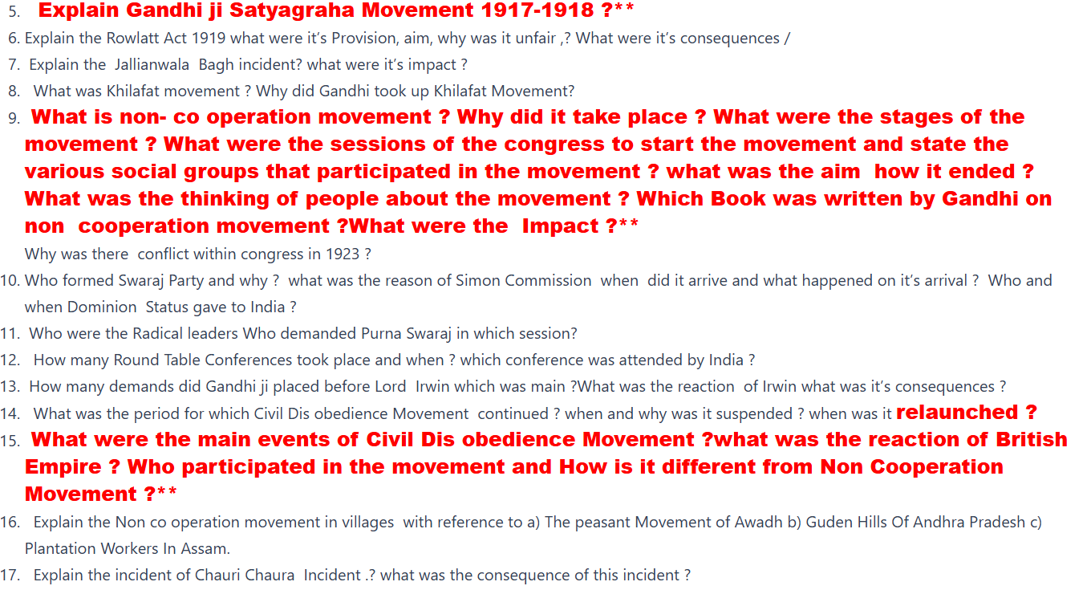

Slide 6
18. Explain the salt March of 1930 ? what are the sense of collective belonging with reference of uses of figure or images , India folklore , Use of Icon and symbols of flags , Reinterpretation of History .
19. What is Forex Flag (Swadeshi flag) when was it developed ? which kind of flag (Sawraj flag) was given by Gandhi ji
2o Which act did not permit plantation workers to leave the tea garden ? How Did the worker understand the idea of Swaraj ? What were the Slogan given by a) Subash Chandra Bose b) Bal Gangadhar Tilak C0 Ram Prasad Bismil d) Bhagat Singh ?
21.Why did Cabinet Mission came to India in 1946? when did India got independence who was the Prime minister of Britain at that time ?
22.Which of the following is correctly matched a) Sardar Patel contributed in Hindustan Socialist Republic army b) Bhagat Singh in Sawraj Party c) C.R.Das in Bardoli Satyagraha d) J. L .Nehru in Oudh Kisan Sabha (2024)
23.How did the people of different communities, region and languages group to develop the sense of collective belonging in late 19 th century Explain**

Slide 7
Making the world global
i) Trade is the activity of ————–.ii) What was Global interconnectedness during 3000bc iii)Who was Christopher Columbus what did he discover ?
What is Chutney Music ? What is the role of Silk Route?**
What are indentured labour ? Why was it described as new system of slavery ?
What was Corn Laws ? What was the effect of abolition of Corn Laws ?
Why were Europeans attracted to Africa to establish their colony ?
Explain how is food offers are long distance Cultural Exchange ? Foods from America , Noodles from China and introduction of potatoes in Europe ?
What was the Economic Effects on Britain due to first world war ?
What was Opium trade and Rinderpest ?
What was the effect of great depression on agriculture, banks, and US loan Crisis ?
What do you mean by NIEO what is aim to establish G-77.
What is Bretton Woods Agreement? When was he conducted the conference and what was it’s aim.
What is Sericulture ? Who was V.S. Naipaul.
“The new crops could make the difference between life and death ” Explain the statement in the context of Irish Potato ?
Define a) Hosay, b) Veto ,c)Tariff d) Exchange rates.
Which country Germany/ England / France/ Portugal did not take part in first world war ?

Slide 8
16.Who adopted the concept of assembly line to manufacture automobiles a) Samuel Morse b) Henry Ford ?
17.What is AI – Dorado in Latin America .? What are Canal Colonies. ?
18.The first world war was fought between Which countries ? The geographical Exploration in Africa was directly linked to a) Vast land with rich resources b)Imperial projects c)Labour to work.
19.When did Potato famine took place in Ireland and about how many lives were lost ? Who worked in American plantation in 18 century ? Why were the people from Europe flee to America in 19 century ?
20. Why India cotton business remain same even the demand in Britain decline ?
Printing Culture and Modern World
In which aera printing was developed first of all ?where was it spread later on ?
In which aera printing was developed first of all ?where was it spread later on ? How were the books printed in China 798AD. Who introduced hand printing in China with whom ? The Oldest Japanese Book Printed 868AD.
In which aera printing was developed first of all ?where was it spread later on
How were the books written before the printing press was invented ? What is calligraphy ?
Added Which was the first country to recruit the Civil Servant through exams ? In 16th century the printing was confined to which field in China ? Mechanical printing press introduced in China in —— century

Slide 9
6.Who invented printing Press and when ? which was the first book printed ? Adde Name the country which revolutionaries the printing in Europe ?
7 What were the main Features of handwritten manuscripts ? AddedThe manuscripts were written ——- leaves or ——— papers in ———– languages they were highly expensive and ————
8.Which kind of printing became popular in Europe in 15th century ? Who brought the method of woodblock printing to Italy ? What is wood block method in which field were it widely used.? How did the printing culture created the condition of French Revolution?
9.Explain the Visual culture in printing and the role of Raja Ravi Verma in the field .
10. How did printing popularized the idea of enlightenment thinkers ( give the example of Voltaire and Rousseau)
11. Adde Explain the development of reading mania in Europe ? Who were Chapmen their role in reading mania?
12.What was the name given to low priced books in France and why ?What was the role of Periodicals Presses in reading mania?
13.What was the impact of printing over Indian Women How they acted upon it.
14.Who brought the printing culture in India? Name the first Indian Language in which books were published ? When and which was the first Tamil book and Malayalam book published? When was English printing started in India?
15.Explain The Vernacular Act 1878 of press . why was it imposed ?
16.What did the Grimm Brothers Published ?
17.What was Protestant Reformation?
18.Explain Reasons for bringing large number of readers among children, women and worker in 19 century.?
19.Why was Martin Luther in Favour of Printing

Slide 10
