Slide 1
Geography
Important Questions
Class X
toppershome.online

Slide 2
Resources and Development
What is Resource ? What are it’s feature ? give examples.
What are biotic and abiotic resources give it’s example . ( Resorces on basis of Origin)
What are Renewable & non Renewable resources give example ? ( Resource on the basis of Exhaustibility )
Define : a)Individual Resource b) Community owned resource c) National Resource d)International Resource e)Potential Resource f) Stock g) Reserve resource.
What is Sustainable development and why is it essential for development ? What is land degradation ? What are the main causes of land degradation and how can it be prevented ?
What is soil erosion ? what are main causes explain with reference to human activity and natural ?
What are Gully Wind and Sheet erosion? Write the Methods by which Soil Erosion can be checked .
By the report of 2000 India waste land was % of water eroded, forest degradation , wind eroded land ?
Write the % of plain Mountain and Plateaus present in India?
What are Resources planning? Give it’s Stages. Explain the Resources Conservation ?
Name the two type of Alluvial Soil ?How is it formed and it’s characteristics ?
Main crops which can be sown in Alluvial soil are of four types which are they ? Write the region in which it is found ?
Regur soil is also called ———. Where is it found and formed ?
What are the main character of Regur soil very useful for cultivating i)——–ii)—— iii)——–
How soil in Odisha ,Chhattisgarh is yellow or red in colour ? How is it formed and used in cultivation of ——?

Slide 3
16.Tea ,Coffee ,and Cashew nuts needs the soil _______ where it is found and what are the main characteristic of the soil ?
17.What is the other name of desert soil ?Why is it red to brown in colour? How is it formed ? where are they found in the country for which crops are they useful?
18.The loamy and silty in valley side and coarse in upper slopes are the type of which kind of soil mostly used for which kind of crops ?
19.What is land utilization ? Define a)Land not available for cultivation b)Uncultivated land c) Fallow land d) Net sown aera e)Piedmont zone f) Decca trap region g) Duars,chos ,terai h) Arable land i) Desertification.
20.Which state in the north east states has fully surveyed for land use a)Manipur b) Assam c) Tripura .
21. Agenda 21 was signed in 1992 for which motive and in which country ?
22,What kind of soil is it which develops in the aera of high temperature, intense leaching due to heavy rain with less humus content(2024)
Forest and wild life
Define the following: i) Natural Vegetation ii) Wild life iii) Flora iv) Fauna v) Eco- system .vi) Zoological Park vi) Wild life Sanctuaries vii)Biodiversity .
India has how many plant species and flowering plant species. How many species of animals, birds and insects are present in India ?
How many types of forest in India ? How is ecological imbalance is created ?
When was project tiger launched in India? When was ” The Indian Wildlife Protection Act” implemented in which years the provisions were added to it ? Which mineral mining in west Bengal is threat to tiger.
Who can play vital role in the conservation of forest and wildlife ?
How is biological loss take place and can be corrected

Slide 4
6. what are Taxol? As per UN report per head trees in India are ——-.and that highest in the world in ———-.
7. What is the rise in temperature of our environment after every 5 years.
8.What are Normal species give example .
9.Define a)Endangered species b)Vulnerable species c)Rare species d) Endemic species e) extinct species.
10. Which of the following are Normal, Endangered ,Vulnerable ,Rare , Endemic or extinct species . i) Sal ,Pine , Rodents ii)Blackbuck ,Blue sheep, Crocodile ,Himalayan Brown Bear ,Wild Asiatic Buffalo ,Desert Fox, iii) Hornbill, Gangetic Dolphins ,Indian Rhino iv) lion Tailed Macaque. Andaman Teal , Nicobar pigeon, Andaman wild pig , Mithun in Arunachal Pradesh , Asiatic cheetah , Pink head duck.
11. What is full form of IUCN .
12.What are the causes of the depletion of forest land ?
13.What are the reasons for decline of in the bio diversity ?Why do we need to conserve bio -diversity ?
14.Write the methods to conserve the forest and wild life ?**
15. What are reserve forest ,protected forest and uncalled forest ?
16.Name the trees which are considered the sacred one ?Where is Sarika tiger reserve why is it important ?
17.Why is Chipko Movement famous and role of community ?
18.What is Beej Bachoo andolan and Navdany . Which bird is disappearing from Delhi region
19.What is JFM Programme which the first state to adopt JFM

Slide 5
Water Resources
Glaciers/ ground water/ surface run off/Oceans which not the source of fresh water.
According to Falkan Mark, Water stress occurs when i) water availability is less than 1000 cubic meter per person per day ii) There is flood iii) There is no water scarcity .
What are the causes of water scarcity.? Water of Bhakra Nagal is used for many purposes what are they ?
Bhakra Nagal Dam located on which rivers ? Which Dam is located on the Mahanadi ?
What are guls or kuls ? What are Khadins/johads ? What are Tankas in Rajasthan ?Bamboo drip irrigation system is present in which state ?
Rooftop rain water harvesting is made compulsory in which state ? Why is Gendathur have rare distinction in water ?
What is fresh water? What is % of ocean water and fresh water ? What is % of fresh water that comes from ice sheets give example ? How do fresh water mainly comes from ?
What do you mean of hydrological Cycle ? Name three main sources of fresh water ? What is water scarcity for which aera are they associated ?
How is population and agriculture leads to scarcity of water ?
How is urbanisation and industrailisation are responsible for creating the scarcity of water?
How is the quality of water is deteriorating ?
What are the adverse effects of over- exploitation of ground water resources ?What is Inundation channels ?
What are the main causes of water pollution ? What are the important measure for water conservation ?
What is Dam and what is Multipurpose river valley projects ? What was the comment given by Nehru ?
What are the advantages and disadvantages of Multipurpose river Valley projects ?
What is Narmada Bachao Andolan explain ?

Slide 6
AG RICULTURE
If India is an agriculture country then what % of population is involved in it ?Is it primary /secondary activity what does it produces as food product , raw material for which industry ,which products to earn foreign exchange ?
What is Primitive Subsistence farming ? How and why is it done ? When the fertility of soil decreases what does the farmer do and why ? Why is the land productivity is low ?**
How is Intensive Subsistence farming done ? Why it’s yield per hectare is high ? What kind of cropping is done?
What is Commercial agriculture? How is it done and what are it’s inputs?**
What kind of crop Rice for Punjab and for Odisha ?
What is plantation agriculture? What are it’s main characteristics?
Name the three seasons of cropping ? When are seeds sown in rabi crops when are they harvested name the important crops in rabi. What is the other name of Kharif Crops when are the seeds sown and harvested Give important names of crops .What is Zaid Season and it’s main crops .?**
Name the cropping seasons of Wheat , Barely, Rice, Maize ,Millets, Mustards , watermelon , muskmelon Pea , Groundnuts , Cotton ,Jute, cucumber.
Rice : position in world, largest producer in world , producing state WHEAT : position in world , state producing . JOWAR : position and state producing SUGARCANE : position in world ,largest producer in world ,state producing OILSEEDS : position in world , name the major oil seeds produced in India . TEA and COFFEE producing states , COTTON : Position holding in world, soil used major state JUTE : growing states RUBBER producing states
Write the institutional reforms of agriculture ? What is Horticulture ?

Slide 7
11.Name the food crops ,cash crops, Horticulture crops ?
12. Define Green Revolution , White revolution ,Yellow revolution , Blue revolution , Gene revolution .
13.In the states like Assam , West Bengal and Odisha three which paddy crops are grown ?
14. Which crop is used as fodder and food crop ? Name the three millets which have high nutritional value ?
15. Write the status of India in groundnuts and rape seeds ? which are the largest producers ?
16.What is crop rotation ?
17.What is the name is given to slash and Burn Agriculture in India in other parts of India such as MP, Andhra Pradesh , Odisha , West Ghats , Manipur ,Andaman and Nicobar Island .
18.Which is correct for Rabi Crops a) Sown in winter b) Sown in October- December and harvest from April -June c)important Mazie, cotton and Jute d) Punjab, Haryana and UP are the major places for production of wheat ( 2024)
ii) Correct match the group 1) I Wheat a Millets crop 2) ii Ragi b beverage crop 3) iii Tea c Food Crop 4) Iv Maize d food and fodder crop

Slide 8
Mineral and Resources
What are Minerals defined by Geologist? How are they identified ? What are rocks ? Name the rocks consist of single mineral ? What is ore ?
How are minerals generally occur ? What are Veins and lodes Which are the metals found in veins and lodes ? How do mineral occurs in igneous and metamorphic form?
How is sedimentary rocks minerals formed Give examples? Which kind of minerals are formed by the decomposition on surface ?
Name . 3 the minerals occurs as alluvial deposits in sands of valley floors and base of hills what are they called ? Are the minerals found in corroded form?
What kinds of minerals are contained in ocean water ? Name the mineral richly found in ocean water ?
Name the four types of Iron Ore ? What are the% content found in Magnetite and Hematite ?
Badampahar Mines is found in which belt ? what kind of iron do we get from there ?
Which mine is found in Durg-Bastar-Chandrapur belt ? Iron from this ore is exported to which countries ?
Kudremukh Mines are in which belt and state ? The slurry / ore is transported to which port ?
Ratnagiri district of Maharashtra lies in which belt and exported through which port ?
Name the Aluminum Ore Why is it important metal Write it’s qualities ? Which of the Indian state has highest deposit of Aluminum? Name the aera of Koraput district famous for Aluminum ?
Name the mineral found in leaves or plates Why is very useful for electric or electronic industry.
Which state is the leading producer of Mica , Name the important belt. and leading producer of state ?
What are the dangers involved in mining made in India ? How does the mining adversely effect on the environment?

Slide 9
14.What are the difference between Conventional and non -Conventional sources of energy .?
15.Coal is an important source of energy how? Give three points.
16.Explain how coal as an industrial raw material a) Name the industry for which it provides raw material b) What are the coal based products c) as a fossil fuel.
17. Name the four types of coal? Name the coal of highest quality & % of carbon . What is Bituminous coal it’s % of carbon and mostly used in in which metallurgical system ?
18.What is the colour , Moisture ,Reserve of Lignite Coal ? Name the coal reserve.
19.Name the coal which have low content of carbon and high moisture with low heating capacity and burning with smoke ?
20.What is the age of Gondwana Coal Belt and Tertiary Coal belt ? Where is Damodar Valley Belt Name the coal mines present in it .Name three belt found in Gondwana belts ? Tertiary coal belt in which Northern eastern states ?
21.How is Petroleum an important fuel explain the reasons .? How does it act as nodal industry for which industry
22.Explain the % of petroleum in Mumbai High ,Gujarat and Assam .
23.Oil fields as Ankaleshwar ,Digboi ,Naharkatiya and Moran Hugrijan belongs to which state.
24.which mineral are required for Nuclear energy where are they found ?
25.Name the device which changes solar energy into electricity ? Where is the largest solar plant located ? How does it help in conservation of fuel and ecosystem ?
26.Why India is known as wind super power ? which is the largest cluster in India for wind Energy name the othe center for wind energy in India .
27.How can bio gas produced and why is it useful for agriculture ? Why should the cattle cake be discourage?
28. Paravati Valley near Manikarn and Puga Valley in Ladakh are famous for which kind of non conventional energy.
29.Why is energy important give examples and how can we conserve it ?
30.Name the eco friendly fuel? Balaghat Copper mine is located in which state

Slide 10
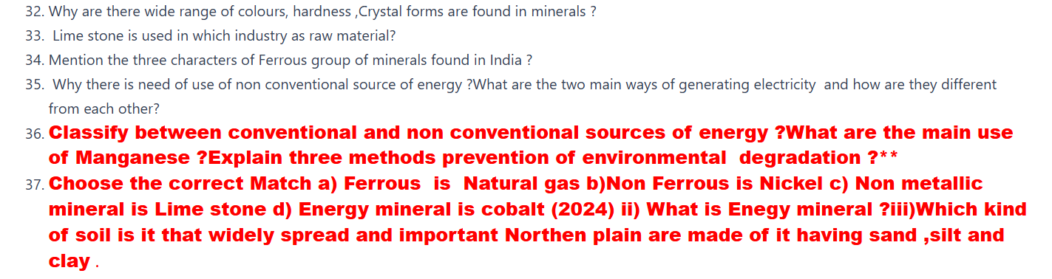
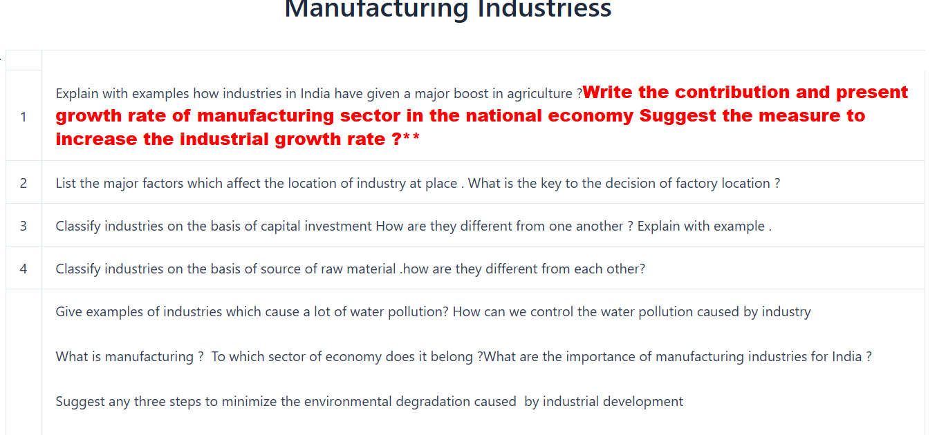

Slide 11
