Slide 1
Democratic Politics
Important questions
Class X
toppershome.online

Slide 2
POWER SAHARING
Which language was recognized as the official language of Sri Lanka in 1956.
Apart from Central and State Government which is the third type of government in Belgium . What is the language spoken by the people of Belgium.
Define Majoritarianism ? What measure were taken by democratically elected government of Sri Lanka to establish Sinhala Supremacy. What were it’s consequences’
What do you mean by check and balance system. What is vertical division of power ?**
Explain the problems of culture diversity faced by Belgians and Sri Lanka?
How far do you agree that power sharing keeps the spirit of Democracy.**
In Belgium, Which speaking community had conflict with Dutch speaking people in1950-60.
Mostly Sinhala belong to which Community ?
Which Language is spoken mostly in Brussels? Give the examples of powered shared among different social groups . Which community is rich and powerful in Belgium. Which are the languages spoken in Belgium
Where is the head -quater of European Union Located.?
Write the three measures taken by Belgium to accommodate regional and cultural diversity .? How did Belgium solve Ethnic problem**
Why is power sharing desirable (2024) ii)What is the primary objective of separate government in Brussels ? iii) Which constitutional term is used for the government which has no official religion and all communities have freedom to profess and practice any religion they like

Slide 3
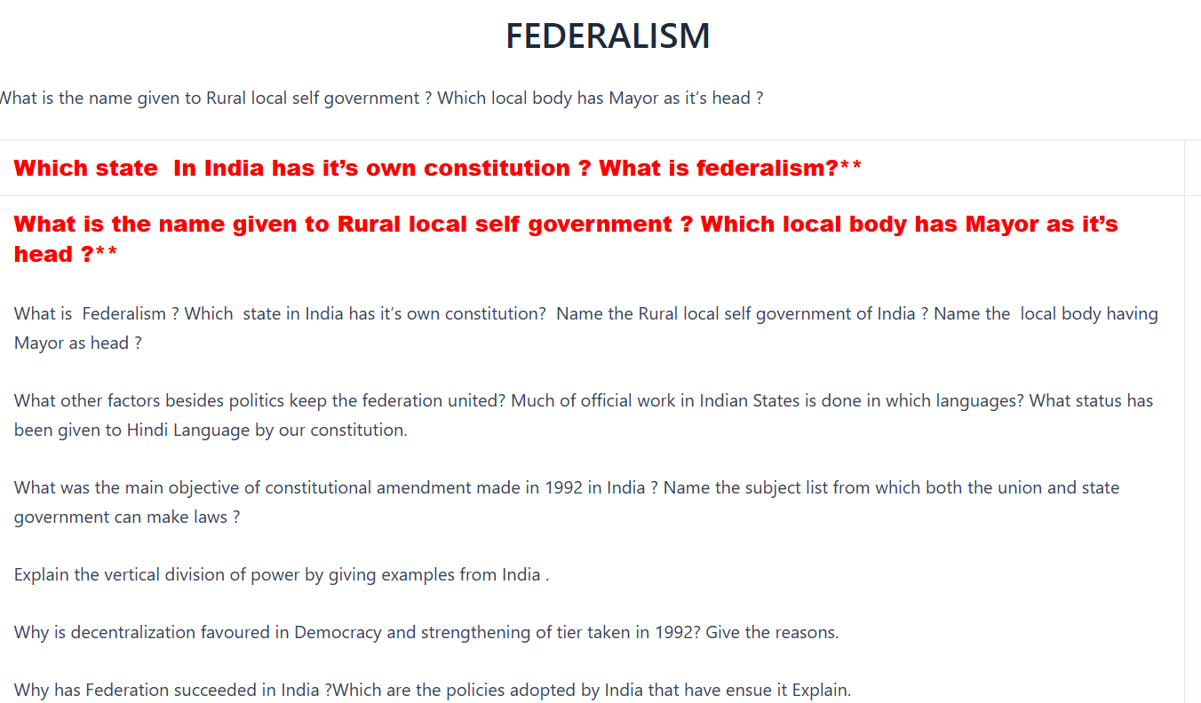

Slide 4
Which country is good example of holding together federation? Union and state Government makes the laws on which subject ? What is the need of local self government ?
What are residuary subjects who makes the law ? Analyse the center and state relation before and after 1990?
How did Indian Federation tackle the challenge of language policy?
What is Gram Sabha ? Explain it’s work.
What is the fundamental Principle of democracy? Education, Adoption, Communication and Marriages comes under which list(2024

Slide 5
Gender ,Religion and caste
What % of seats reserved for women in local bodies ? Who is Feminist ? Explain the status of women representation in India legislative bodies ?
What is the total population of SC,ST,OBC in our country?
Mention the two provision which make India a secular state ?
Taking Vote on the religious grounds and caste ridden politics is against the principle of democracy.
How does religion influence the political set up of our country ?
What is Feminist Movement? Explain the political demands of Feminist Movement of India ?**
Why do the Government of India give holidays on the religious festivals explain.
Define a)Caste Hierarchy b)Communalism c) Sexual division of Labour d)Patriarchy
Explain How can Communalism takes various forms in politics ?
Give reasons that caste barriers breaking down in India? What was Gandhi thought about Religion and Politics in India ?
Explain Division of labour on the basis of sex.?Why is there discrimnation against Women?
What was Equal Remuneration Act ? What do you mean by occupational mobility ?What is Urbanization?
Which term is used for social, political and economic equality for women .(2024) Which language is added in the constition of 8th schedule.*

Slide 6
Political Parties
What is meant by Political Parties ? What are it’s main component? what are recognized political party? What special privilege are given to them by Election Commission.? What is National political parties and how is it different from state political party ?
How many parties are needed in a democratic system to conduct free and fair election?
What is the main source of inspiration and guideline philosophy of BJP.
In which state Biju Janta Dal exists .Name the state in which Rashtriya Lok Dal exist .
What is Universal Adult Suffrage stands for ? What is the difference between pressure group and political parties ? Why did India adopt the multi party system ?
Give the names of the personalities which are the main source of inspiration of Bahujan Samaj Party .?
Name the Two regional parties of West Bengal? Name of of the political party that have national level organisation but not recognised as national political party ? Name the political party which grew out of a movement ?
Mention the ideology of Indian National Congress.
Mention the important features of BJP .
Lack of internal democracy within the parties is the major challenge to political parties Explain .
Dynastic succession is the serious problem for the political parties discuss.
What is meant by regional political parties ? State the conditions they to be recognized as regional political party.
Give your suggestions to reform needed in political parties ?

Slide 7
14.Explain the growing role of money and muscles in political parties.?
15.Explain the major functions of political parties? Why are they important for democracy of country?**What are the responsibities be carried out by political parties of India (2024)
15.What is the role of Opposition party in the democracy?
16.Define a)Ruling Party b)Defection c)Affidavit d)Partisan e)Alliance or Front f)State Funding of Election g)Types of political Parties (with example)
16. When was the first general election took place in India ? Who was the first Chairperson of BJP? Who was the first Chair person of Bahujan Samaj Party?
17.When did anti defection act came into power
18.Which Country in the world has one party system
Outcomes of Democracy
How can you say that democracy are based on political equality ? What is transparency in democracy how does government ensures it ? What are the main role of democratic form of government .E
What are the major difference between democracy and dictatorship ?
” An ideal government would not keep itself away from corruption but also make fighting corruption and black money at top priority ” justify the statement

Slide 8
4.Explain the role of Government in reducing the economic disparities .
5.Discuss that democracy seems to be good in principle but not good in practice
6.Discuss that democratic government is legitimate government ? It accommodate social diversities How?
7.Explain the values by which we can make Democracy better for citizens of the country.
8.Define a)Accountability b)Political Equality c)Electorate d)Sovereignty e)By election
9.What are political, social and economic out come of democracy.?
10.How is democratic politics make the life of people of the peaceful justify (2024) ? How is democratic government is better than the oher kind of government ? Democracy accommodate social diversities Explain

